Slide 1







SUBSTANCE ABUSE
PREVENTION
PROGRAMMES
STOPPING DRUG USE BEFORE IT STARTS
Government Run & Grant Operated Programmes
2009
2009
2010
2010
2013
2016
DRUG PREVENTION IS A SIMPLE PROCESS THAT REALLY DOES WORKS.
Notes:
Drug Prevention speaks specifically to stopping drug use before it starts. It is designed to foster a climate in which alcohol use is acceptable only for those of legal age and only when the risk of adverse consequences is minimal. Prescriptions and over-the-counter drugs are used only for the purposes that they are intended and illegal drugs are not used at all.
Drug prevention is a process that will empower school-aged children to make the right decision when it comes to alcohol tobacco and other drugs. The benefits of drug prevention for Bermuda include a healthy community in which people have a qualitative life free from drugs and crime. Drug prevention will give our social groups like the churches and sporting clubs the opportunity to stay connected and offer support to our youth.
Once young people have a supportive environment that provides opportunities, skills and recognition it reduces the likelihood that they will use drugs and alcohol. Drug prevention is a simple process that really does works.
Effective programmes are culturally sensitive and include interactive educational components that are enjoyable for youth. It is also imperative that prevention programming involve parents or guardians. Prevention programames should have a component that applauds those parents who do take time to listen to their children and encourage those parents who lack parenting skills.
Drug prevention makes a difference in the whole community and presents the opportunity for partnerships and collaboration. Prevention keeps the community in a healthy and happy state of mind.
The Prevention Unit of the DNDC is an advocate for curriculum based drug prevention education. Prevention programs should be long-term, over the school career with repeat interventions to reinforce the original prevention goals.
For example, school-based efforts directed at elementary and middle school students should include booster sessions to help with critical transitions from middle to high school and beyond.
Prior to 2009 there was little to no curriculum-based drug education. Emfforts are now in place to ensure that educators have the skill sets to deliver drug prevention education as part of the local education system.
One of our first curriculum-based programmes is that of our Als Pals Programme…..

Slide 2


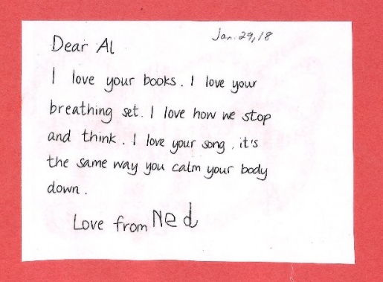

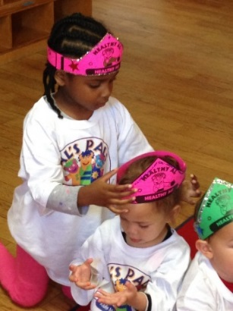
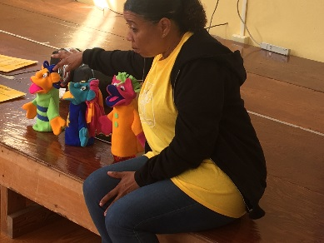
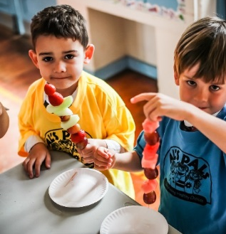

In 2014, 14
schools and ALL PRESCHOOLS were using the programme.
Preschool Lower Primary
Better classroom management.
Children have a better understanding that tobacco, alcohol and other drugs are not for children.
926 students in P1 & P2, 533 students offered exposure.
OUTCOMES
THE DNDC
Evidence Based
177 educators trained.
The Al’s Pals: Kids Making Healthy Choices (Als Pals) is a nationally recognized model early childhood curriculum and teacher training programme that is delivered by trained educators. The objective of the programme is to promote the protective factor of social emotional competence and to decrease the risk factor of early and persistent aggression or antisocial behaviours among the early childhood student population.
Buy in at the Ministerial level.
To be a part of the curriculum.
CHALLENGES
Notes:
Al’s Pals is a comprehensive curriculum and teacher training programme that develops social-emotional skills, self-control, problem-solving abilities, and healthy decision-making in children ages 3-8 years old.
The program is recognized as an evidence-based model prevention programme and has received top rating by the National Center on Quality Teaching and Learning in their Social-Emotional Preschool Curriculum Consumer Report.
The programme operates using fun lessons, engaging puppets, original music, and effective teaching approaches.
Al’s Pals:
Helps young children regulate their own feelings and behavior, allowing educators more time for creative teaching by reducing the need for discipline.
Creates and maintains classroom environments of caring, cooperation, respect, and responsibility.
Teaches conflict resolution and peaceful problem-solving.
Promotes appreciation of differences and positive social relationships.
Prevents and addresses bullying behavior.
Conveys clear messages about the harms of alcohol, tobacco and other drugs
Builds children’s abilities to make healthy choices and cope with life’s difficulties.
The programme was piloted in June 2009 with full implantation September 2009 and has been utilized throughout the public and private sector since that time.

Slide 3


Students achieved higher pro anti-drug attitudes at post- testing time.
Gained an increased perception of wrongfulness on items describing a peer drinking alcohol and hard liquor, smoking cigarettes and smoking marijuana.
Middle School
High School
OUTCOMES
Evidence Based
10 primary schools 22 classes with 327 students and 283 retained.
Botvin’s LifeSkills (LST) is a research-validated substance abuse prevention programme proves to reduce the risk of alcohol, tobacco, drug abuse, and violence by targeting the major social and psychological factors that promote the initiation of substance use and other risky behaviours.
78 students engaged and 71 retained.
Being able to identify adequate
time to run the programme.
Buy in from the administration.
Relying on the school councellors to
implement the programme .
Funding to allow expansion.
CHALLENGES
99% of the curriculum completed.
Notes:
During this same year PRIDE Bermuda implemented the Botvin’s LifeSkills Training (LST). PRIDE would focus on school-aged children between the ages of 9-12 years. LifeSkills is a research-validated substance abuse prevention programme proven to reduce the risk of alcohol, tobacco, drug abuse and violence by targeting the major social and psychological factors that promote the initiation of substance use and other risky behaviours. The LifeSkills Programme runs in selected classrooms at the primary, middle and highschool levels during the school year. This comprehensive programme provides adolescents and young teens with the confidence and skills necessary to handle successfully challenging situations. Rather than merely teaching information about the dangers of drug abuse, Botvin’s LST consists of three major components – drug resistance skills, personal self-management skills, and general social skills – that cover the critical domains found to promote drug use. To date PRIDE’s Botvin’s LST runs in 10 primary schools.

Slide 4

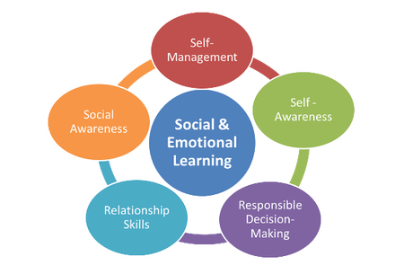
Middle School
High School
Increased knowledge of ATOD’s.
Increased perception of risk for items describing binge drinking, chain smoking, regular marijuana use and regular drinking.
Students acquired drug knowledge at post-test by answering more questions correctly at the end of the programme.
OUTCOMES
Evidence Based
Botvin LifeSkills Training promotes healthy alternatives to risky behavior through activities.
Botvin’s LifeSkills (LST) is a research-validated substance abuse prevention programme that proves to reduce the risk of alcohol, tobacco, drug abuse, and violence by targeting the major social and psychological factors that promote the initiation of substance use and other risky
behaviours.
Running the programme with fidelity.
78 students engaged and 71 retained.
CHALLENGES
Notes:
Shortly after, CADA joined up with PRIDE to implement the programme at the middle and high school levels, currently at Somersfield and BHS.

Slide 5

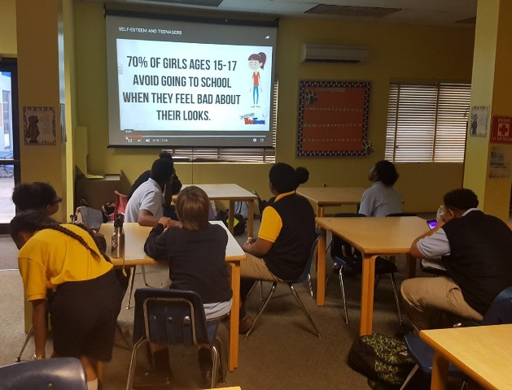
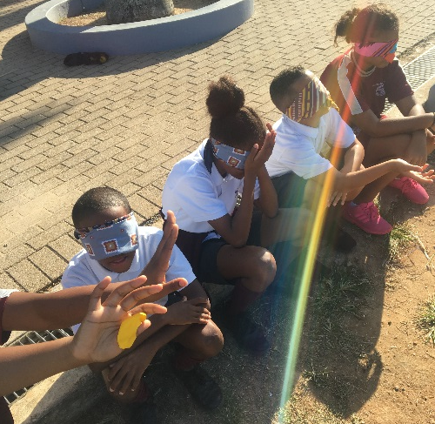
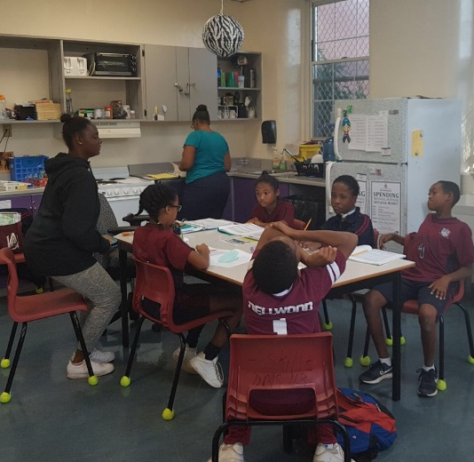
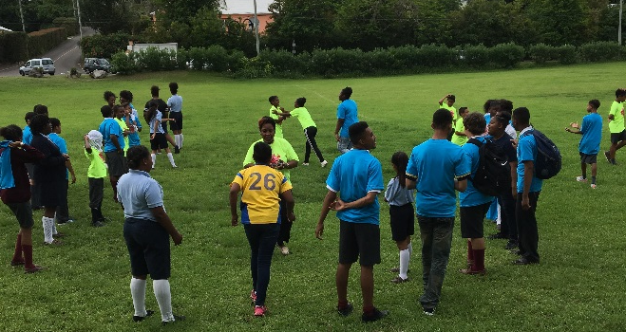
Served 54 students in 2016/17 school year
Middle School
Students are better equipped for situations that may arise.
Students have the opportunity to engage with students at other middle schools.
Students have access to a positive adult for the school year.
Evidence Based
OUTCOMES
Available to all middle aged school students.
THE DNDC
TEEN PEACE is a substance abuse prevention afterschool programme designed to keep children and youth out of trouble and engaged in positive and enriching activities. LifeSkills (LST) is a component of the programme.
Collecting data in the afterschool setting.
Getting students to commit.
Parental Involvement.
CHALLENGES
Notes:
In 2010 the Teen Peace Program received the support of the Department of Education as an after-school alcohol and drug prevention programme for middle-school aged students. Implementing the Botvin’s LST in an after school setting as one of the components in the Teen Peace programme.
Research supports the utilization of after-school programmes in preventing alcohol and drug use, reducing delinquency, providing youth with positive, pro-social role models, and promoting alternatives to delinquent behaviors, while learning and incorporating positive social and emotional skills as an approach to addressing alcohol and marijuana use and affording opportunities to practice and develop resilience and problem solving skills along with positive peer relations.
Teen Peace seeks to educate and develop the student’s psycho-social skills to face positive situations where they are at risk of using drugs.
Between the hours of 3:00 pm and 8:00 pm children are most vulnerable and susceptible to engage in anti-social behaviors such as gangs, stealing, trespassing in addition to using alcohol and drugs
Teen Peace was designed specifically for Bermuda’s middle school aged students and is based on the theory of Social Emotional Learning (SEL) which targets a combination of behaviors, cognitions, and emotions while utilizing the gender responsive approach such as:
Self-awareness – knowing one’s needs and values
Social awareness – showing respect for others
Self-management and organization – controlling impulses, aggression, self-destruction and anti-social behavior
Responsible decision making – Analyzing situations perceptively and identifying problems clearly
Relationship management – managing conflict, negotiation, refusal
Teen Peace is implemented in a fun empathic age appropriate manner which includes cultural excursions, team building exercises, and drama and art projects amongst planned activities.
All staff for the programme receive training in the theory of social emotional learning, and Botvin’s LST and were chosen as a result of their love and ability to communicate with young people.
Teen Peace operates two days a week at the five middle schools. A light snack and transportation home is provided to those who need it.
The programme requires a commitment from both students and their parent/guardian.

Slide 6

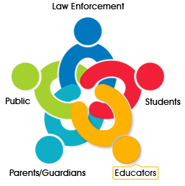
6
weeks in
18 primary schools
13 weeks in 5 middle schools.
Primary School
Middle School
BERMUDA POLICE
Evidence Based
Teachers have seen a benefit of having the program and noted that some students shown some improvement.
G.R.E.A.T Gang Resistance Education And Training is an effective gang and violence prevention program built around school-based, law enforcement officer-instructed classroom curricula. The Program is intended as an immunization against delinquency, youth violence, and gang membership for children in the years immediately before the prime ages for introduction into
gangs and delinquent
behaviour.
OUTCOMES
Difficulty collecting statistics.
Behaviour of some students which the teachers cannot address effectively as the students
are so far gone.
CHALLENGES
Notes:
Gang Resistance Education And Training G.R.E.A.T. was initially implemented in Bermuda in the late 1990's and that segment finished in 2003. It was re-implemented in 2013 by the Ministry of National Security to assist with combatting the gang mentality of youth and to provide a conduit between law-enforcement and youth in an effort to build better relationships. G.R.E.A.T. is being delivered to all primary and middle schools during the 2018/2019 school year by Police and Customs officers. It is expected to be delivered to about 600 students.

Slide 7


Reduce aggressive and destructive behaviors amongst primary school children.
Increase executive functioning skills.
Increase social and emotional competencies.
Primary School
109
students retained.
92% of the curriculum completed.
OUTCOMES
Evidence Based
PROMOTING ALTERNATIVE THINKING STRATEGIES (PATHS)
PATHS curriculum is a model social and emotional learning programme that was designed to help children develop self-control, positive self-esteem, emotional awareness, and interpersonal problem-solving skills; and it has been recognised for its effectiveness.
With the programme being new and the teachers teaching the 2 lessons twice a week it’s proving to be a challenge to run the programme with fidelity.
Assessing each student at the beginning and ending point of the programme.
CHALLENGES
Notes:
PRIDE Bermuda’s PATH’s programme, Promoting Alternative THinking Strategies (PATHS) curriculum is a model social and emotional learning programme that was designed to help children develop self-control, positive self-esteem, emotional awareness, and interpersonal problem-solving skills; and it has been recognised for its effectiveness. In 2016 this programme was coordinated by PRIDE Bermuda and, in the last two academic years, the curriculum was delivered to one primary school and has increased to two.

Slide 8


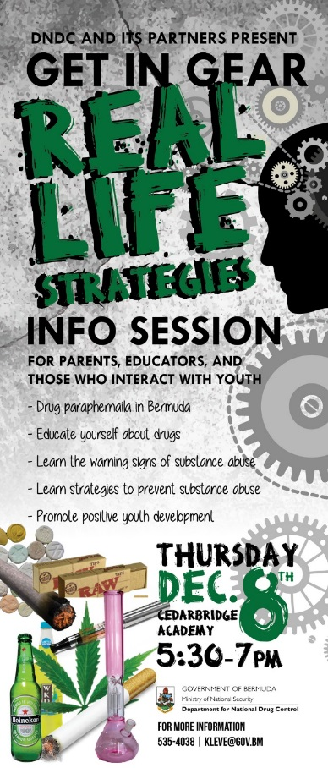

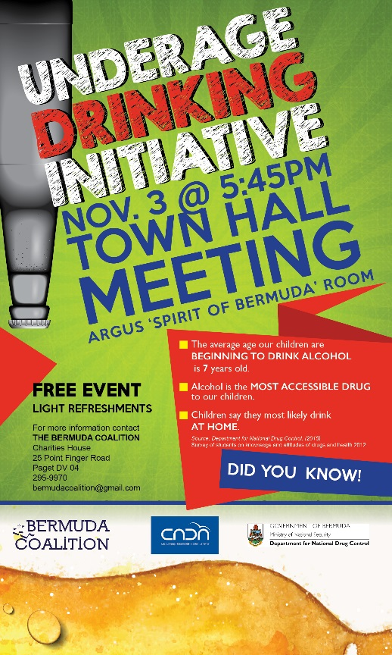


PREVENTION EFFORTS
Notes:
Thank you to those Departments, Agencies, Youth Groups and passionate people undertaking drug prevention work throughout the community. The DNDC will continue to support these prevention efforts by holding presentations, collaborating, and providing educational materials when needed.

Slide 9

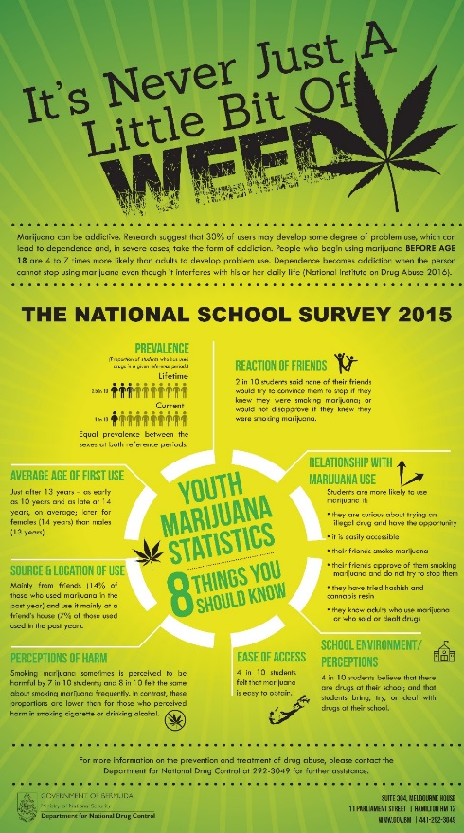
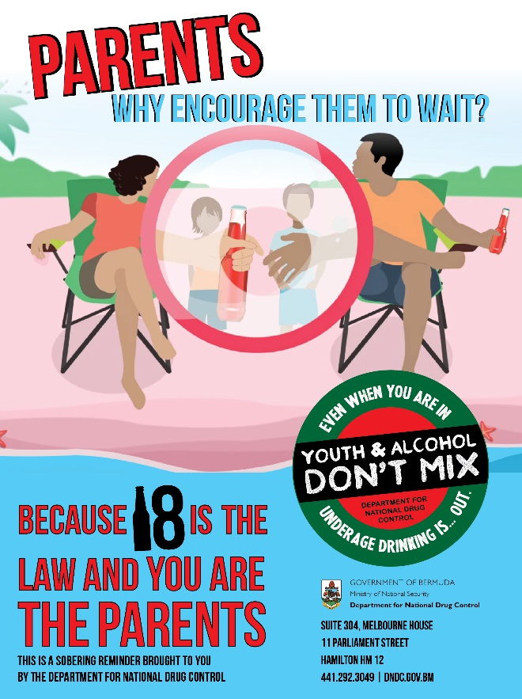
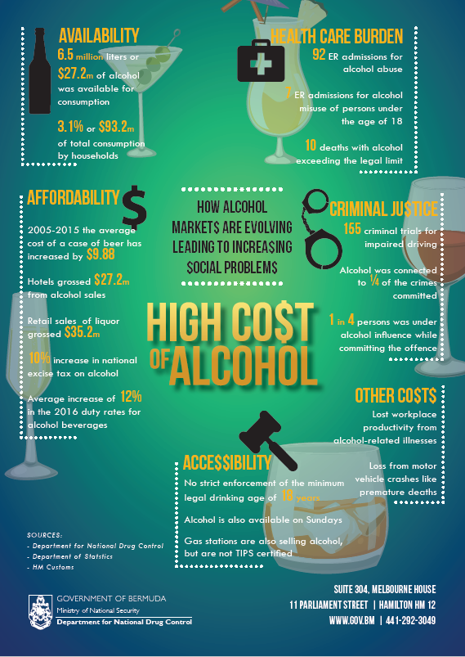
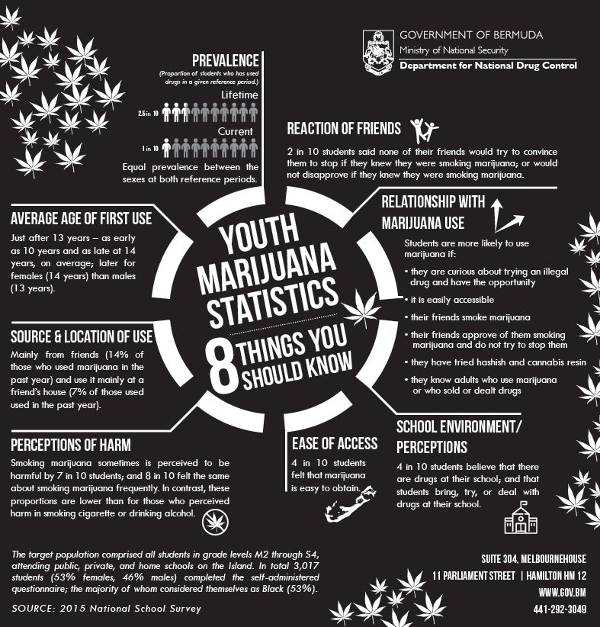
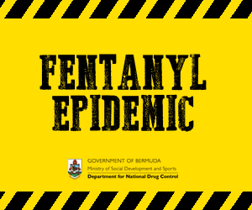
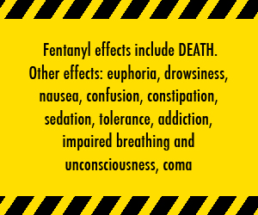
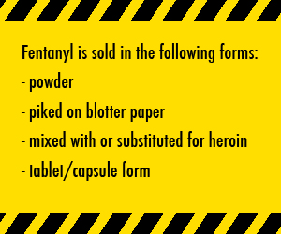
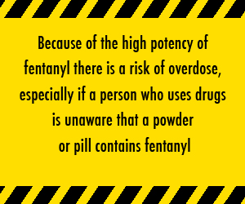
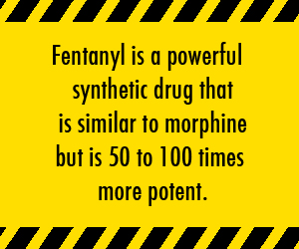
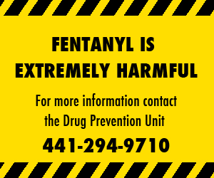
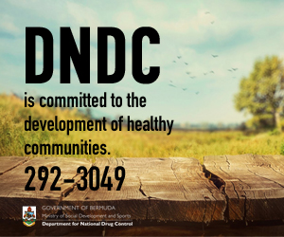
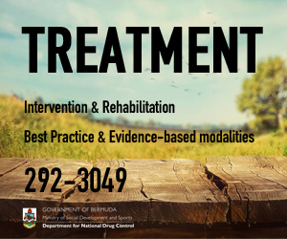
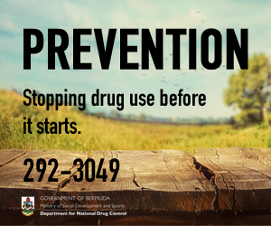
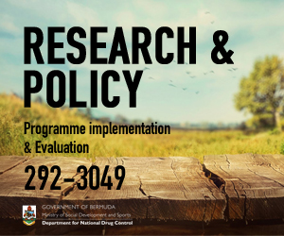
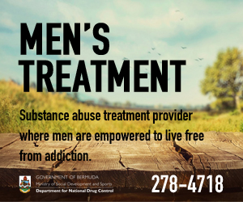
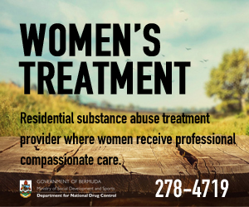
PREVENTION ADVERTISING

Slide 10


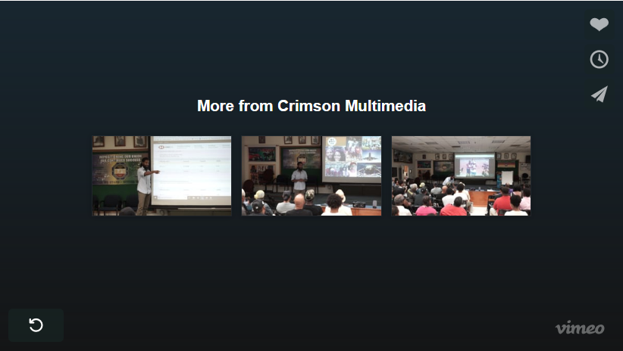
CURRENT AD CAMPAIGN
Notes:
https://vimeo.com/294506236

