Slide 1

2024 ANNUAL MEETING OF THE
BERMUDA DRUG INFORMATION NETWORK
The Drug and Alcohol Landscape
in Bermuda
  Kyla Raynor, DrPH
  BerDIN Coordinator
  Senior Research Officer/Policy Analyst, DNDC
  November 1st, 2024
  Bermuda Underwater Exploration Institute
Notes:
Welcome everyone to the 2024 meeting
With most of the membership here today, I like to thank you for your continued efforts to provide the very best information we can collect to inform the drug situation in Bermuda
There have been a number of challenges for all of us over the past year but, I would like to encourage each of us to think about how we can improve on how we collect information and/or how we can improve upon the process to ensure quality information is available

Slide 2
“There is immense power when a group of people with similar interests gets together to work toward the same goals.”
– Idowu Koyenikan

Slide 3

BERMUDA DRUG INFORMATION NETWORK (BerDIN)
1998
2006
2008
Mandated by United Nations Office on Drugs and Crime (UNODC)
Throne Speech Initiative
National Drug Information Network formed in Bermuda
  14th
Annual Bermuda Drug Information Network Meeting
Notes:
This information network was started because of a directive from the United Nations.
In 1998, they mandated that counties provide key drug related information for comparability from country to country.
In Bermuda, the BerDIN was formed in 2008, took a hiatus for 4 years and then reengaged in 2012.
As challenging as the past year has been, you remain engaged evident by your participation in the meeting.
Despite having our own challenges, we are here for the 14th annual meeting

Slide 4
BACKGROUND
MISSION
The BerDIN is committed to providing the evidence that allows for discussions and decisions to be informed by sound, centrally available, local data, on a wide range of issues that increase understanding of the complex, dynamic, and evolving nature of the Island’s drug problem.
FACILITATED & COORDINATED BY DNDC
Collect, collate, monitor, analyse, interpret, produce, and disseminate.
Standardise drug literature dissemination mechanism and processes.
Conduct primary drug-related research.
Provide technical assistance and capacity building.
PURPOSE
→ Build a Bermuda picture to analyse the situation and the evolution of the phenomenon and responses.
→ Compile information used to monitor and assess the implementation of the national drug strategy.
OBJECTIVES
To provide information essential for policy making, organisation of drug-related services, and on drug-related issues of general interest.
Identify existing drug abuse patterns
Identify changes in drug abuse patterns
Monitor changes/ emerging drug problems
Raise awareness through dissemination of information
Integrate agencies involved in drug reduction or control
A group of individuals or an organization dedicated to providing Bermuda with accurate, unbiased, and comparable information about drugs, drug addiction, and their consequences.
Notes:
Our mission, purpose, and objectives are all tailored to contribute to the development of policy and the implementation of appropriate programmes and responses to the current drug situation.
The DNDC’s job really is to collect the information and make sense of it all through the annual publication.
The agencies making up the Network provide national information that assists the public, policy makers and anyone working in this field with having a local, culturally-relevant picture of the current substance use/misuse situation in Bermuda.

Slide 5
IMPORTANCE OF THE BERDIN
Multi-faceted Approach
Uses a multi-source, multi-indicator system to provide insight into various aspects of the drug problem because substance use is a difficult and complex phenomenon to monitor.
Centralised Reporting Hub
Provides a platform for agencies to report and share their information.
Collaboration & Collective Knowledge Exchange
Brings together various institutions and individuals involved in diverse aspects of the drug problem: drug prevention, treatment, education, control, health, and law enforcement.
Comprehensive Drug-Related Focus
Creates a holistic approach to address the various facets of drug-related issues, thereby promoting a more effective response.
5
Notes:
There is no one piece of information that can inform the drug situation in Bermuda. It requires a multitude of information from various sectors in order to observe, monitor, and evaluate the drug situation, even at times using proxy information
BerDIN also allows each of the Member agency’s information to be showcased, whereas, in some agencies, there is no reporting mechanism.
We all come from diverse areas AND so this meeting, brings all of us together who have a vested interest in demand and supply reduction, thereby creating a holistic approach…

Slide 6
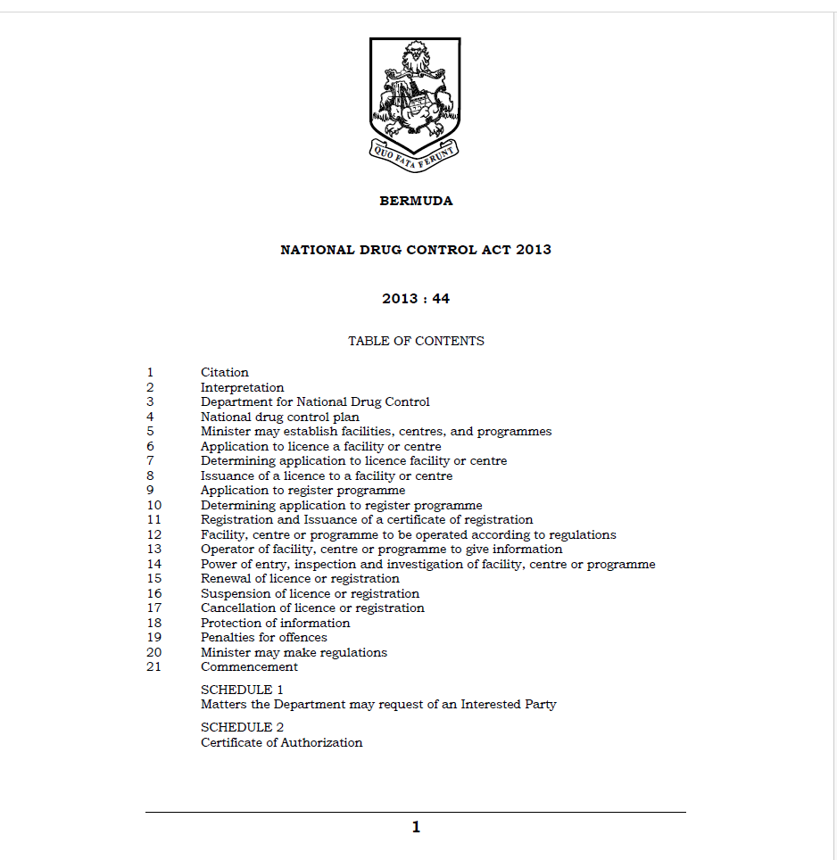
NDC ACT 2013
section 3 g, h, i, j
Notes:
The NDC Act of 2013 empowers us to seek out the information needed to inform the drug situation.
I have never had to refer to the Act because I believe relationship building has been key to our development and progress with sharing of information in the Network.
You can recall once upon a time there was a 2 day meeting where we put resources into ensuring day 2 of the meeting was spent on professional development as a thank you to the members for their continued support.
And while this past year has been challenging for a number of agencies, it is my hope that we can get back on track!

Slide 7

ORGANISATIONAL CHALLENGES
STAFFING
Shortages
Turnover
Burnout
DATA
Vital indicators not reported by 3 agencies.
TIMELINESS
Target submission date not met by 25% of agencies.
QUALITY
Some agencies not verifying data before submission
Validity checks not built into process for a number of agencies
7
Notes:
During 2023, agencies continued to struggle financially because of decreased budgets which resulted in challenges related to staffing, therefore meeting deadlines and just having a resource person that could provide us with the information we are hoping to receive is less of a priority…which we understand.
Since the pandemic, there have been a number of governmental and non-governmental agencies that have been simply unable to meet demands and, in a few cases, have had to make tough decisions in order to continue operating but in a limited capacity.
There were 4 agenices (BPS- crime information, DPP- outcome of alcohol and drug court cases and BHB. We have already resolved the issue with BHB and will be able to make that data available in next year’s publication, however despite our best efforts, the crime data and supreme court information remain an issue to be resolved.
When it came to submission of your information we know that there are competing priorities with some agencies between their own work related deadlines and the BerDIN deadline every May 15th.
When So agencies need to have a verification process in place to ensure confidence in the data that is being released.
Lastly, we want to continue to press that in order to provide good quality local data we must built validity checks into your process prior to submission in the data management system. This year in particular, we were tasked with having to follow up with agencies when the data just didn’t look as it should.

Slide 8
MISSING DATA FROM BERDIN REPORT
Crimes
Type of Drug Enforcement Activity
Criminal Trials for Drug-Related Offences by Sex of Offender
Criminal Trials for Alcohol-Related Offences by Sex of Offender
Criminal Acquittals for Drug-Related Offences by Sex of Offender
Criminal Acquittals for Alcohol-Related Offences by Sex of Offender
Criminal Convictions for Drug-Related Offences by Sex of Offender
Criminal Convictions for Alcohol-Related Offences by Sex of Offender
Unknown Results for Drug-Related Offences by Sex of Offender
Unknown Results for Alcohol-Related Offences by Sex of Offender
Quantity, Value, and Duty of Tobacco and Tobacco Products Exported from Bonded Warehouses
Illicit Tests by Sport
Triage Assessment for Addictive Disorders Results by Number of Participants
Primary Diagnoses of Inpatient Drug-Related Cases
Primary Diagnoses of Inpatient Cases of Poisoning and Toxic Effects of Substances
Secondary Diagnoses of Inpatient Drug-Related Cases
Secondary Diagnoses of Inpatient Cases of Poisoning and Toxic Effects of Substances
Primary Diagnoses of ER Drug-Related Cases
Primary Diagnoses of ER Cases of Poisoning and Toxic Effects of Substances
Secondary Diagnoses of ER Drug-Related Cases
Secondary Diagnoses of ER Cases of Poisoning and Toxic Effects of Substances
Primary Diagnoses of MAWI Drug-Related Cases
Secondary Diagnoses of MAWI Drug-Related Cases
Secondary Diagnoses of MAWI Inpatient Cases of Poisoning and Toxic Effects of Substances Cases
PRIDE Bermuda’s LifeSkills Programme Statistics
8
Notes:
So that you have a sense of the indicators that are missing, I have listed them here so that you can see what I am referring to.
Points 1-4 of this slide contains information that we use to obtain from BPS and is now missing from the report.
At the end of each meeting we encourage each of you to have bilateral meetings and in that regard, We have tried numerous times to figure out a plan to move forward but we are met with promises of resolution without actually obtaining a resolution
Point 5, although not confirmed, because it was difficult to get a response to my query from the BPS court liaison, the issues with very little data in the JEMS system is believed to also be related to BPS.
An example of how the data are interrelated….Today we will have a presentation from the BPS on alcohol related stops for 2023. To complete the picture for DUI cases, we would reply on information from the supreme court that speaks to the number of trials and acquittals related to those stops. This year however, without having information from the Court, those correlations can not be made.
Point 6- with the implementation of the new BHB system, we were unable to provide any information from the old system.
So as we move forward we need to seriously think about as a Network we can work towards getting back to where we were two years ago and how we improve our processes.

Slide 9
11 chapters published in 2023
10 chapters published in 2024
For a chance to win a gift, what chapter is no longer in the Report?
9
Notes:
SUBSTANCE ABUSE PREVENTION DATA

Slide 10
KEY INDICATORS
Substance-related facts
Decrease
in DTC and DUI referrals, admissions and completions
Decrease in number of youth and adult substance referrals
More reception inmates positive for illicit drugs
Increase in Occasional Liquor Licences
Increase
in treatment admissions
10
Notes:
There have been some decreases in programme referrals and admissions over the past year and increases in other areas such as the number of occational licences issued and minor increases in treatment admissions.

Slide 11
KEY INDICATORS
Substance-related facts
Pregnancy-related THC use
Total number of tests
10
Total number of positive tests
11
Notes:
Data from the Maternal Health Clinic shows a decline in the number of women testing positive for THC , which is something to be celebrated.

Slide 12


2023 RETAIL SALES INDEX
& CUSTOMS DUTY
Estimated Liquor Store Sales ($mil)
Estimated Duty Collected on Alcohol ($mil)
Source: Department of Statistics
Notes:
Here we have the 2023 estimated liquor store sales in millions on the left and the estimated duty collected on alcohol in millions on the right.
This slide shows that alcohol continues to be a large source of taxes collected on an annual basis.
Not surprising but as you can see the months of July and December had the highest gross sales of alcohol.

Slide 13
TREATMENT REFERRALS & ADMISSIONS
Source: Bermuda Assessment Referral Centre, MT, WTC, Turing Point, FOCUS, Salvation Army
Notes:
Despite a decline in formal treatment referrals, there was an increase in persons being admitted the treatment facilities between 2022 and 2023.
It is possible some of these admissions were self-referrals.

Slide 14
SUBSTANCE OF CHOICE
  New clients had moderate clinical diagnosis vs existing clients who were likely to have severe diagnosis.
Source: Bermuda Assessment Referral Centre (BARC)
Notes:
These graphs show the substances of abuse or dependence by persons prior to a determination of the appropriate level of care.
From both charts we know that alcohol remains the drug of choice of those who presented for assessment over the past 2 years, however in 2023, marijuana and not cocaine was the substances most often indicated for abuse or dependence.

Slide 15


PERSONS IN TREATMENT
TREATMENT AGENCY | 2022 MALE | 2022 FEMALE | 2022 TOTAL | 2023 MALE | 2023 FEMALE | 2023 TOTAL
WTC | - | 6 | 6 | - | 8 | 8
MT | 3 | - | 3 | 17 | - | 17
TURNING POINT | 196 | 30 | 226 | 233 | 45 | 278
SALVATION ARMY HARBOUR LIGHT | 9 | - | 9 | 20 | - | 20
SALVATION ARMY LIFE SKILLS | 2 | - | 2 | 5 | - | 5
FOCUS | 7 | 1 | 8 | 7 | - | 7
RLH | 8 | - | 8 | 8 | - | 8
TOTAL | 225 | 37 | 262 | 290 | 53 | 343
15
Source: Bermuda Assessment Referral Centre (BARC)
Notes:
This slide is self explanatory but I will point out that between 2022 and 2023 there was an increase in the number of admissions to treatment facilities. As you can see Turning Point followed by the Salvation Army saw most clients.

Slide 16
LEVEL OF SEVERITY OF
SUBSTANCE ABUSE OR DEPENDENCE
Source: Bermuda Assessment Referral Centre (BARC)
Notes:
Again of those with substance abuse or dependence, most had severe abuse or dependence.

Slide 17
IMPAIRED DRIVING
DUI STOPS
BREATHALYSER RESULTS
  Most persons stopped were 1 to 2 times above legal limit
Males were 1-2 times over the limit ,while females tended to be 2-3 times above the limit
Source: Bermuda Police Service
Notes:
In 2023, 177 persons were stopped and undertook the test of which 149 were male and 25 female. And as you can see in the graph on the right, most persons who were stopped failed the breathalyzer test.

Slide 18
DUI CLASS PARTICIPATION
Source: Bermuda Professional Counselling Service and FOCUS
Notes:
In 2023, FOCUS saw 5 participants in their DUI class despite the increases we just observed in impaired driving rates.
Focus Counselling Services provides The Flex Module Impaired Driving Series approved by the Government of Bermuda in accordance with Section 35 (K) of the Road Traffic Act 1947.
This program satisfies the courts to make an order for the reduction in the period of disqualification under Section 4 of the Traffic Offences (Penalty) Act 1976 of a DUI/Impaired driving offender, upon successful completion.
The Flex Module Impaired Driving Series is a flexible version of the most widely replicated model for impaired driving offender intervention education. Certified addictions counsellors provide this participant-focused, user-friendly curriculum that offers a personalized road map for good decision-making; aligns with local impaired driving education standards; includes a personal change plan that can being integrated across the course; emphasizes personal responsibility and commitment to change drinking and driving behaviour; and moves beyond basic education to application of effective strategies for behaviour change.
The program runs for a six-week cycle totalling 12 hours with 2 hours per session and is held on Wednesday evenings from 5:30 pm to 7:30 pm at cost of $425. Full payment is required prior to programmme participation. The cost of the programme includes all materials. A certificate of completion is provided to all participants who complete the full programme along with application for reduction in disqualification period. The programme is geared toward Impaired Driving offenders and offender prevention.

Slide 19
MORTALITY DATA
2022
2023
Source: Central Government Lab
Notes:
When it came to those who died under suspicious circumstances…..
There were increased in the number of people who died who were over the legal limit of alcohol and had drugs in their system upon death. Additionally, there were an increase in suspicious deaths to people who had only drugs in their system at the time of death.

Slide 20
DEMAND & SUPPLY REDUCTION EXPENDITURE
Source: Department of Finance
Notes:
The impact of overall decreased funding over the past several years has resulted in decreased/limited client services mainly due to staffing
A number of persons seeking care were unable to get into treatment over the past year while others waited for longer periods than usual
Substance abuse treatment: largest component of the budget saw level funding for the past 3 years.
This includes DNDC’s treatment programmes, grant agencies, RLH and turning point.
When it came to Substance use prevention
prevention unit of the DNDC saw level funding over the past year
prevention grant-recipient agencies saw level funding also for the past 3 years
When it came to the Interdiction budgets: BPS saw a decrease in their budget compared to the last budget cycle, while hm customs saw level funding.

Slide 21

DATA GAPS
CRIME
Drug arrests, persons stopped and warned for cannabis (7g legislation), drug availability, drug market
01
03
JUSTICE
Public expenditure on drug offenders in prison
TREATMENT
Problem drug use, dual-diagnosed clients, drug-related harms, treatment gaps
02
04
ECONOMY
Cost of problem drug use to society
05
ARCHIVAL DATA
Recapturing data that previously was published, if feasible
21
Notes:
Again over the past 2 years there has been some regression in the availability of information, most are listed on this slide.
While we have done a lot of great work, there remains key areas we would like to further research, the pressing ones are listed here. Ideally, we the new drug strategy we would like to ensure that a few of the pressing issues are addressed

Slide 22
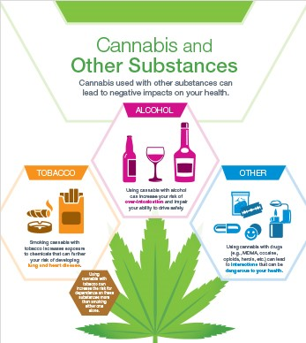
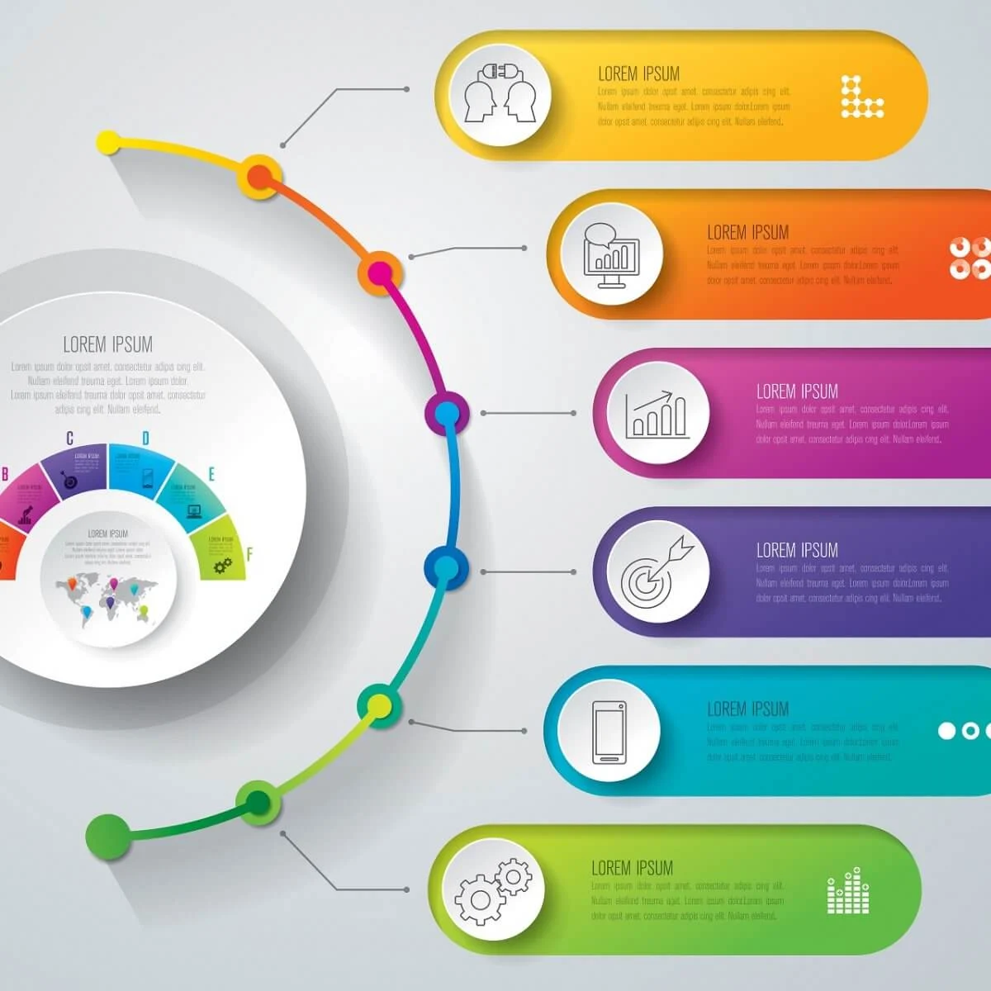

BEYOND 2024
Drug Strategy
Evaluation
New Strategy
Needs Assessment
Data Gaps
Archival data
New data
Further relationship building
Research
Review data collection methodology
Notes:
In 2025 we will begin to evaluate the goals and objectives we said we would implement during the cycle of the Plan.
This will be followed by a community wide needs assessment and development of a new drug strategy
Closing data gaps and new research methods will also be apart of the way forward.

Slide 23

GOVERNMENT OF BERMUDA
GOV.BM
Notes:
I would like to remind you that all of the data produced by the DNDC Research Unit can be found on the government portal
However if there is something you can not find or if you are in need of customized data please contact us

Slide 24
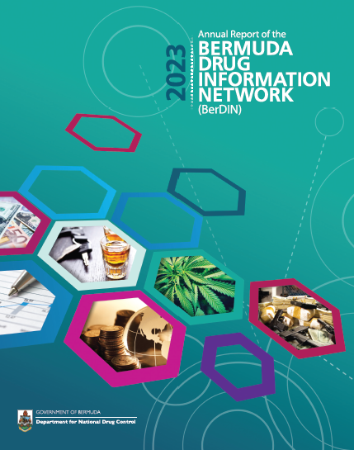
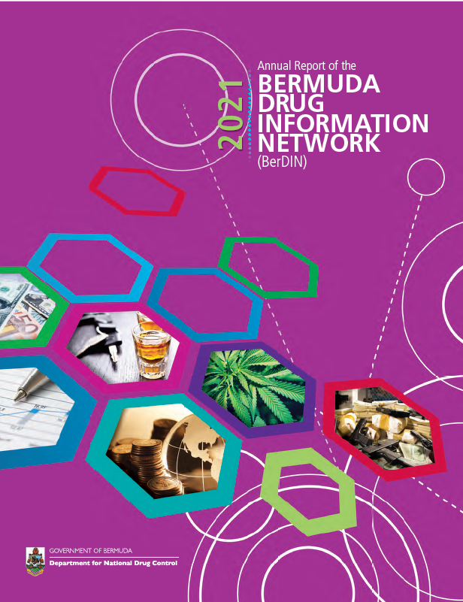

THANK YOU!
Notes:
We all should feel proud of contributing to and producing these 14 publications.
publications that stand as a resource – an evidence base – to both policy makers and the community alike
IT IS THE NUMBER ONE SOURCE OF COLLECTIVE INFORMATION RELATED TO DEMAND AND SUPPLY REDUCTION ON OUR ISLAND.
IF YOU HAVE ANY IDEAS OF HOW WE MAKE THESE BETTER OR MORE USEFUL DO LET US KNOW

