Slide 1
Framework for Improving Critical Infrastructure Cybersecurity
September 2017
cyberframework@nist.gov

Slide 2
International Dialogs
Used by over 30% of U.S. organizations, trending to 50% (per Gartner)
Used by the United States Government
Used by international governments and orgs:
Japanese translation by IPA
Italian adaptation within Italy’s National Framework for Cybersecurity
Hebrew adaptation by Government of Israel
Acknowledged as best practice by the insurance industry
Marsh McLennan, ABI, ACE, AEGIS, AIG, AIRMIC, Allianz, Aspen, Barbican, Beazley, Brit insurance, CFC underwriting, Guy Carpenter, Hiscox, Lloyd’s, Tokio Marine Kiln, XL, Zurich

Slide 3
Improving Critical Infrastructure Cybersecurity
“It is the policy of the United States to enhance the security and resilience of the Nation’s critical infrastructure and to maintain a cyber environment that encourages efficiency, innovation, and economic prosperity while promoting safety, security, business confidentiality, privacy, and civil liberties”
Executive Order 13636
12 February 2013

Slide 4
Based on the Executive Order, the Cybersecurity Framework Must...
Include a set of standards, methodologies, procedures, and processes that align policy, business, and technological approaches to address cyber risks
Provide a prioritized, flexible, repeatable, performance-based, and cost-effective approach, including information security measures and controls, to help owners and operators of critical infrastructure identify, assess, and manage cyber risk
Identify areas for improvement to be addressed through future collaboration with particular sectors and standards-developing organizations
Be consistent with voluntary international standards

Slide 5
Development of the Framework
Engage the Framework Stakeholders
Analyze RFI Responses
Identify Framework Elements
Collect, Categorize, and Post RFI Responses
Prepare and Publish Framework
EO 13636 Issued – February 12, 2013
NIST Issues RFI – February 26, 2013
1st Framework Workshop – April 03, 2013
Completed – April 08, 2013
Identify Common Practices/Themes – May 15, 2013
2nd Framework Workshop at CMU – May 2013
Draft Outline of Preliminary Framework – June 2013
3rd Workshop at UCSD – July 2013
4th Workshop at UT Dallas – Sept 2013
Ongoing Engagement:
Open public comment and review encouraged and promoted throughout the process…
and to this day
5th Workshop at NC State – Nov 2013
Published Framework – Feb 2014

Slide 6
Key Attributes
It’s voluntary
Is meant to be customized.
It’s a framework, not a prescriptive standard
Provides a common language and systematic methodology for managing cyber risk.
Does not tell an organization how much cyber risk is tolerable, nor provide “the one and only” formula for cybersecurity.
Enable best practices to become standard practices for everyone via common lexicon to enable action across diverse stakeholders.
It’s a living document
Can be updated as stakeholders learn from implementation
Can be updated as technology and threats changes.

Slide 7
Why Cybersecurity Framework? Cybersecurity Framework Uses
Who uses it?
Inside of critical infrastructure
Outside of critical infrastructure including:
State & local governments
U.S. federal agencies
Governments of other nations
That have a mature cybersecurity risk management program
That don’t yet have a cybersecurity risk management program
Of any size
What do they use it for?
Identify affect of cybersecurity on business
Align and de-conflict cybersecurity requirements
Prioritize cybersecurity outcomes
Organize, authorize, task, and track work
Express risk disposition
Understand gaps between current and target

Slide 8
Continued Improvement of Critical Infrastructure Cybersecurity
Amends the National Institute of Standards and Technology Act (15 U.S.C. 272(c)) to say:
“…on an ongoing basis, facilitate and support the development of a voluntary, consensus-based, industry-led set of standards, guidelines, best practices, methodologies, procedures, and processes to cost-effectively reduce cyber risks to critical infrastructure”
Cybersecurity Enhancement Act of 2014
(P.L. 113-274)
18 December 2014

Slide 9
Cybersecurity Framework Components
Aligns industry standards and best practices to the Framework Core in a particular implementation scenario
Supports prioritization and measurement while factoring in business needs
Cybersecurity activities and informative references, organized around particular outcomes
Enables communication of cyber risk across an organization
Framework Core
Framework Implementation Tiers
Framework Profile
Describes how cybersecurity risk is managed by an organization and degree the risk management practices exhibit key characteristics

Slide 10
Key Properties of Cyber Risk Management
Risk Management Process
Integrated Risk Management Program
External
Participation

Slide 11
Implementation Tiers
 | 1 | 2 | 3 |  | 4
 | Partial | Risk Informed | Repeatable |  | Adaptive
Risk Management Process | The functionality and repeatability of cybersecurity risk management
Integrated Risk Management Program | The extent to which cybersecurity is considered in broader risk management decisions
External Participation | The degree to which the organization benefits my sharing or receiving information from outside parties
11

Slide 12
Intel Adaptation of Implementation Tiers
 | 1 | 2 | 3 | 4
 | Partial | Risk Informed | Repeatable | Adaptive
People | Whether people have assigned roles, regular training, take initiative by becoming champions, etc.
Process | NIST Risk Management Process + NIST Integrated Risk Management Program
Technology | Whether tools are implemented, maintained, evolved, provide effectiveness metrics, etc.
Ecosystem | NIST External Participation + Whether the organization understands its role in the ecosystem, including external dependencies with partners
12

Slide 13
Core Cybersecurity Framework Component
 | Function | Category | ID
What processes and assets need protection? | Identify | Asset Management | ID.AM
 |  | Business Environment | ID.BE
 |  | Governance | ID.GV
 |  | Risk Assessment | ID.RA
 |  | Risk Management Strategy | ID.RM
What safeguards are available? | Protect | Access Control | PR.AC
 |  | Awareness and Training | PR.AT
 |  | Data Security | PR.DS
 |  | Information Protection Processes & Procedures | PR.IP
 |  | Maintenance | PR.MA
 |  | Protective Technology | PR.PT
What techniques can identify incidents? | Detect | Anomalies and Events | DE.AE
 |  | Security Continuous Monitoring | DE.CM
 |  | Detection Processes | DE.DP
What techniques can contain impacts of incidents? | Respond | Response Planning | RS.RP
 |  | Communications | RS.CO
 |  | Analysis | RS.AN
 |  | Mitigation | RS.MI
 |  | Improvements | RS.IM
What techniques can restore capabilities? | Recover | Recovery Planning | RC.RP
 |  | Improvements | RC.IM
 |  | Communications | RC.CO

Slide 14
Core – Example Cybersecurity Framework Component
Function | Category | Subcategory | Informative Reference
Identify | Business Environment | ID.BE-3: Priorities for organizational mission, objectives, and activities are established and communicated | COBIT 5 APO02.01, APO02.06, APO03.01 ISA 62443-2-1:2009 4.2.2.1, 4.2.3.6 NIST SP 800-53 Rev. 4 PM-11, SA-14
14

Slide 15
Core – Example
Cybersecurity Framework Component
Function
Category
Subcategory
Informative Reference

Slide 16
Core for Greater Cybersecurity Participation A Catalog of Cybersecurity Outcomes
“Organizational Inputs”
5
22
98
287
Functions
Categories
Subcategories
Informative References
Reporting

Slide 17
Profile Cybersecurity Framework Component
Ways to think about a Profile:
A customization of the Core for a given sector, subsector, or organization
A fusion of business/mission logic and cybersecurity outcomes
Identify
Protect
Detect
Respond
Recover
An alignment of cybersecurity requirements with operational methodologies
A basis for assessment and expressing target state
A decision support tool for cybersecurity risk management

Slide 18
Cybersecurity Program Objectives Three Things All Cybersecurity Programs Must Do
Support Mission/Business Objectives
Fulfill Cybersecurity Requirements
Manage Vulnerability and Threat Associated with the Technical Environment

Slide 19
Cybersecurity Program Objectives Three Things All Cybersecurity Programs Must Do
Support Mission/Business Objectives
Fulfill Cybersecurity Requirements
Manage Vulnerability and Threat Associated with the Technical Environment
…accomplished through the processes of:
Dependency Analysis
Requirements/Compliance Management
Threat and Vulnerability Management

Slide 20
Profile Foundational Information A Profile Can be Created from Three Types of Information
1
Business Objectives
Objective 1
Objective 2
Objective 3
2
Cybersecurity
Requirements
Legislation
Regulation
Internal & External Policy
Technical Environment
Threats
Vulnerabilities
Subcategory
1
2
…
98
3
Operating
Methodologies
Controls Catalogs
Technical Guidance

Slide 21
Framework Seven Step Process Gap Analysis Using Framework Profiles
Step 1: Prioritize and Scope
Step 2: Orient
Step 3: Create a Current Profile
Step 4: Conduct a Risk Assessment
Step 5: Create a Target Profile
Step 6: Determine, Analyze, and Prioritize Gaps
Step 7: Implementation Action Plan

Slide 22
Resource and Budget Decisioning What Can You Do with a CSF Profile
As-Is
Year 1
To-Be
Year 2
To-Be
Sub- category | Priority | Gaps | Budget | Year 1 Activities | Year 2 Activities
1 | moderate | small | $$$ |  | X
2 | high | large | $$ | X
3 | moderate | medium | $ | X
… | … | … | …
98 | moderate | none | $$ |  | reassess
…and supports on-going operational decisions too

Slide 23
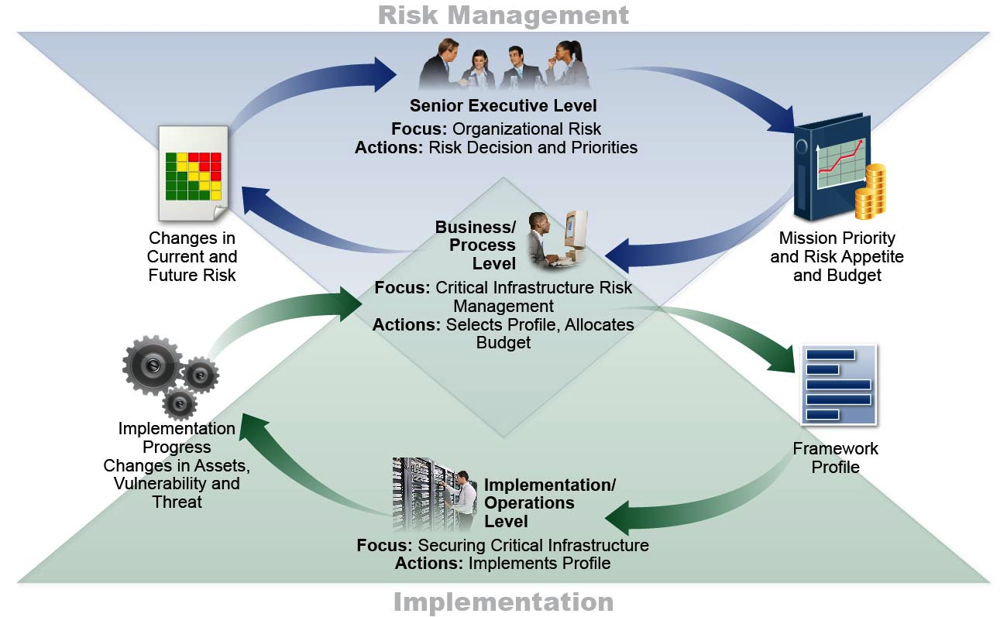
Supporting Risk Management with Framework

Slide 24
Operate Use Cybersecurity Framework Profiles to distribute and organize labor
Subcats | Reqs | Priorities | Who | What | When | Where | How
1 | A, B | High
2 | C, D, E, F | High
3 | G, H, I, J | Low
... | ... | ...
98 | XX, YY, ZZ | Mod
 | Reqs | Priorities

Slide 25
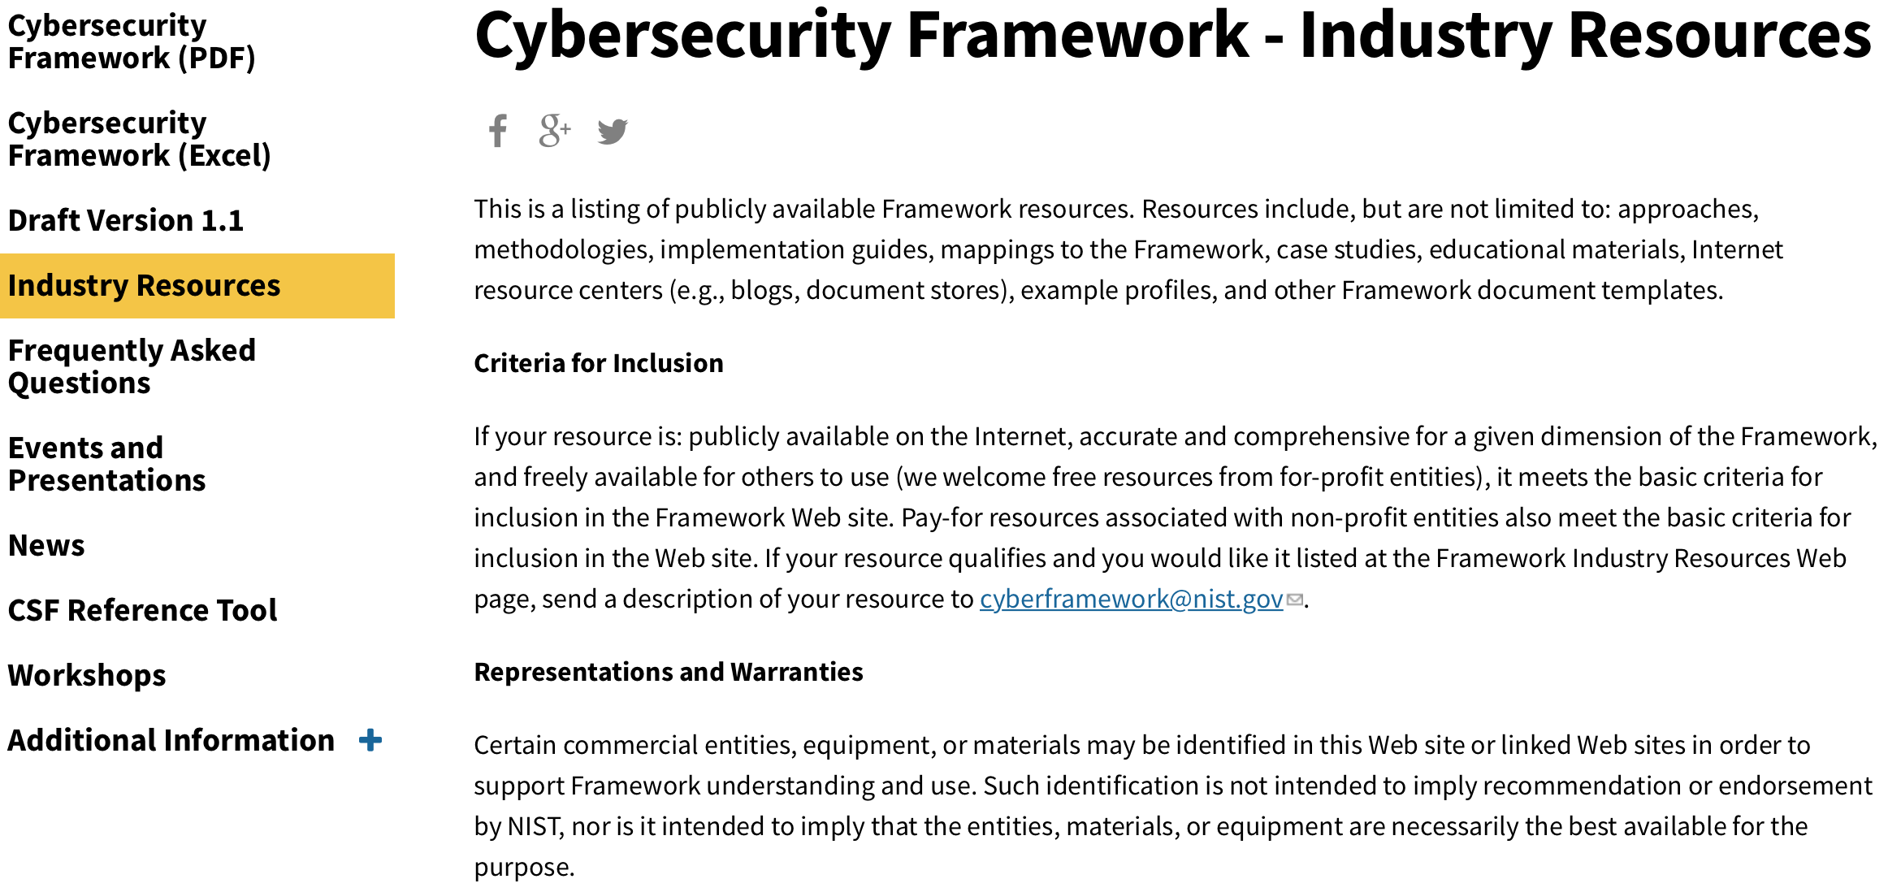
Industry Resources https://www.nist.gov/cyberframework/industry-resources
Over 70 Unique Resources for Your Understanding and Use!

Slide 26
Examples of Framework Industry Resources www.nist.gov/cyberframework/industry-resources
Italy’s National Framework for Cybersecurity
American Water Works Association’s Process Control System Security Guidance for the Water Sector
The Cybersecurity Framework
in Action: An Intel Use Case
Cybersecurity Risk Management and Best Practices Working Group 4: Final Report
Financial Services Sector Specific Cybersecurity “Profile”

Slide 27
Examples of U.S. State & Local Use www.nist.gov/cyberframework/industry-resources
Texas, Department of Information Resources
Aligned Agency Security Plans with Framework
Aligned Product and Service Vendor Requirements with Framework
North Dakota, Information Technology Department
Allocated Roles & Responsibilities using Framework
Adopted the Framework into their Security Operation Strategy
Houston, Greater Houston Partnership
Integrated Framework into their Cybersecurity Guide
Offer On-Line Framework Self-Assessment
National Association of State CIOs
2 out of 3 CIOs from the 2015 NASCIO Awards cited Framework as a part of their award-winning strategy
New Jersey
Developed a cybersecurity framework that aligns controls and procedures with Framework

Slide 28
Recent NIST Work Products www.nist.gov/cyberframework/industry-resources
Manufacturing Profile NIST Discrete Manufacturing Cybersecurity Framework Profile
Self-Assessment Criteria Baldrige Cybersecurity Excellence Builder
Maritime Profile
U.S. Coast Guard Bulk Liquid Transport Profile

Slide 29
Framework Roadmap Items
Authentication
Automated Indicator Sharing
Conformity Assessment
Cybersecurity Workforce
Data Analytics
Federal Agency Cybersecurity Alignment
International Aspects, Impacts, and Alignment
Supply Chain Risk Management
Technical Privacy Standards

Slide 30
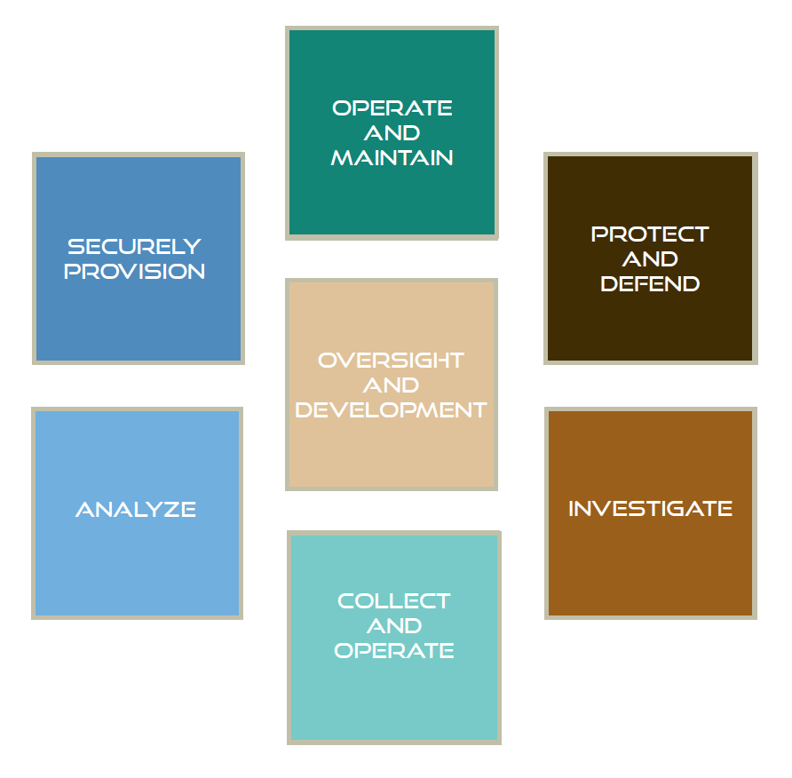
National Initiative for Cybersecurity Education
Early stages of collaboration to show the connection points between Cybersecurity Framework and National Initiative for Cybersecurity Education
Anticipate use cases for
Organizing academic curriculum
Workforce roles and responsibilities
Professional certifications

Slide 31
Framework Roadmap Items
Authentication
Automated Indicator Sharing
Conformity Assessment
Cybersecurity Workforce
Data Analytics
Federal Agency Cybersecurity Alignment
International Aspects, Impacts, and Alignment
Supply Chain Risk Management
Technical Privacy Standards

Slide 32
International Dialogs
ISO/IEC Study Periods and Technical Reports
Proposed Draft Technical Report ISO 27103
Thirty countries have participated in discussion with NIST, including dialog with:
U.S. Border Nations
7 countries in Asia
5 countries in the Middle East
The European Union
14 out of 28 EU Member States

Slide 33
Work in Progress: Framework Roadmap
Authentication
Automated Indicator Sharing
Conformity Assessment
Cybersecurity Workforce
Data Analytics
Federal Agency Cybersecurity Alignment
International Aspects, Impacts, and Alignment
Supply Chain Risk Management
Technical Privacy Standards

Slide 34
Standards and Guidelines for Cybersecurity Risk Management
FIPS - Federal Information Processing Standards
FIPS 199 – Standards for Security Categorization
FIPS 200 – Minimum Security Requirements
SPs – Special Publications
SP 800-18 – Guide for System Security Plan development
SP 800-30 – Guide for Conducting Risk Assessments
SP 800-34 – Guide for Contingency Plan development
SP 800-37 – Guide for Applying the Risk Management Framework
SP 800-39 – Managing Information Security Risk
SP 800-53/53A – Security controls catalog/assessment procedures
SP 800-60 – Mapping Information Types to Security Categories
SP 800-128 – Security-focused Configuration Management
SP 800-137 – Information Security Continuous Monitoring
Many others for operational and technical implementations

Slide 35
Cybersecurity Executive Order 13800 Strengthening the Cybersecurity of Federal Networks and Critical Infrastructure
Risk Management:
(ii) “…agency head shall use The Framework” and
“…provide a risk management report within 90 days containing a description of the “…agency's action plan to implement the Framework.”

Slide 36
Proposed U.S. Federal Usage NIST IR 8170 The Cybersecurity Framework: Implementation Guidance for Federal Agencies
1. Integrate enterprise and cybersecurity risk management
2. Manage cybersecurity requirements
3. Integrate and align cybersecurity and acquisition processes
4. Evaluate organizational cybersecurity
5. Manage the cybersecurity program
6. Maintain a comprehensive understanding of cybersecurity risk (supports RMF Authorize)
7. Report cybersecurity risks (supports RMF Monitor)
8. Inform the tailoring process (supports RMF Select)

Slide 37
Next Steps Framework Update
Key features of this second draft will include:
Update to the measurement section to refine and summarize self-assessment concepts (Section 4)
Integration of the proposed Cyber Supply Chain Risk Management Implementation Tier language into some combination of the other three Implementation Tier properties
Refinement and clarification within Communicating Cybersecurity Requirements with Stakeholders (Section 3.3)
Removal of U.S. federal government applicability statements (Section 3.7)
An evaluation and possible language updates throughout the document to better accommodate Internet of Things and Industrial Control Systems cybersecurity
An additional subcategory in the PR.AC subcategory to address authentication

Slide 38
Next Steps Program Focus
Federal agencies
Small- and Medium- sized Businesses (SMBs)
International organizations, including:
Companies with presence or business outside the U.S.
Other governments
International organizations
Regulators at federal and state levels

Slide 39
Next Steps Stakeholder Recommended Actions
Stakeholders should consider activities to:
Customize Framework for your sector or community
Publish a sector or community Profile or relevant “crosswalk”
Advocate for the Framework throughout your sector or community, with related sectors and communities.
Publish “summaries of use” or case studies of your Framework implementation.
Submit a paper during the NIST call for abstracts
Share your Framework resources with NIST at cyberframework@nist.gov.

Slide 40
Resources Where to Learn More and Stay Current
The National Institute of Standards and Technology Web site is available at http://www.nist.gov
NIST Computer Security Division Computer Security Resource Center is available at http://csrc.nist.gov/
The Framework for Improving Critical Infrastructure Cybersecurity and related news and information are available at www.nist.gov/cyberframework
For additional Framework info and help cyberframework@nist.gov

