Slide 1
Framework for Improving Critical Infrastructure Cybersecurity
International Alignment
September 2017
cyberframework@nist.gov

Slide 2
Industry Use
The Framework is designed to complement existing business and cybersecurity operations, and has been used to:
Self-Assessment, Gap Analysis, Budget & Resourcing Decisions
Standardizing Communication Between Business Units
Harmonize Security Operations with Audit
Communicate Requirements with Partners and Suppliers
Describe Applicability of Products and Services
Identify Opportunities for New or Revised Standards
Categorize College Course Catalogs
As a Part of Cybersecurity Certifications
Categorize and Organize Requests for Proposal Responses
Consistent dialog, both within and amongst countries
Common platform on which to innovate, by identifying market opportunities where tools and capabilities may not exist today

Slide 3
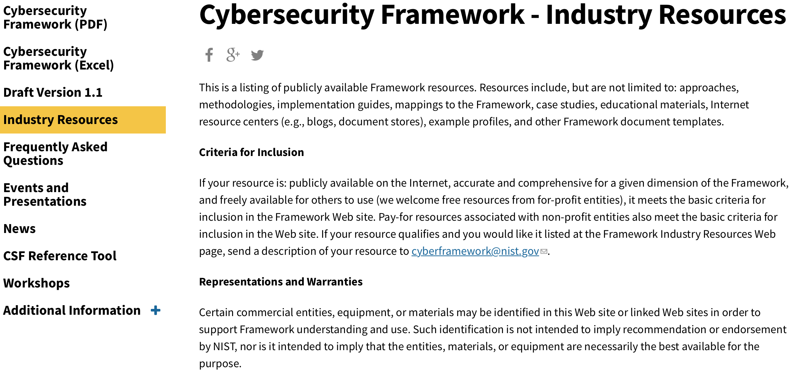
Industry Resources https://www.nist.gov/cyberframework/industry-resources
Over 70 Unique Resources for Your Understanding and Use!

Slide 4
U.S. Coast Guard Maritime Profile
https://www.uscg.mil/hq/cg5/cg544/docs/Maritime_BLT_CSF.pdf
A collaboration between United States Coast Guard (USCG) and National Cybersecurity Center of Excellence
Driven by re-interpretation of the Maritime Transportation Security Act of 2002
Aligns the shared objectives of the USCG and the oil & natural gas industry of maritime bulk liquid transport operations
Helps individual companies clarify how cybersecurity fits into their mission priorities and how best to allocate resources to secure their information and operational systems.

Slide 5
NIST Baldrige Excellence Builders Baldrige Cybersecurity Excellence Builder
Manufacturing
Service
Small Business
Education
Healthcare
Non-profit
Cybersecurity (2017)
Self-assessment criteria with basis in Cybersecurity Framework
Complements NIST Baldrige Program’s performance excellence successes

Slide 6
NIST Manufacturing Profile NIST Discrete Manufacturing Cybersecurity Framework Profile
Utilizing CSF Informative References to create tailored language for the manufacturing sector
NIST SP 800-53
NIST SP 800-82
ISA / IEC 62443
www.tiger-global.co.uk

Slide 7
Examples of Framework Industry Resources www.nist.gov/cyberframework/industry-resources
Italy’s National Framework for Cybersecurity
American Water Works Association’s Process Control System Security Guidance for the Water Sector
The Cybersecurity Framework
in Action: An Intel Use Case
Cybersecurity Risk Management and Best Practices Working Group 4: Final Report
Energy Sector Cybersecurity Framework Implementation Guidance

Slide 8
Italy National Framework for Cybersecurity
A 121 page national framework
Based 100% on NIST Framework
Created with industry and academia
Published in both Italian and English
Suggested Subcategory Priorities for Small and Medium Enterprises (SME)
Qualitative Assessment Criteria
Capture an approach to risk management that is beyond NIST Framework

Slide 9
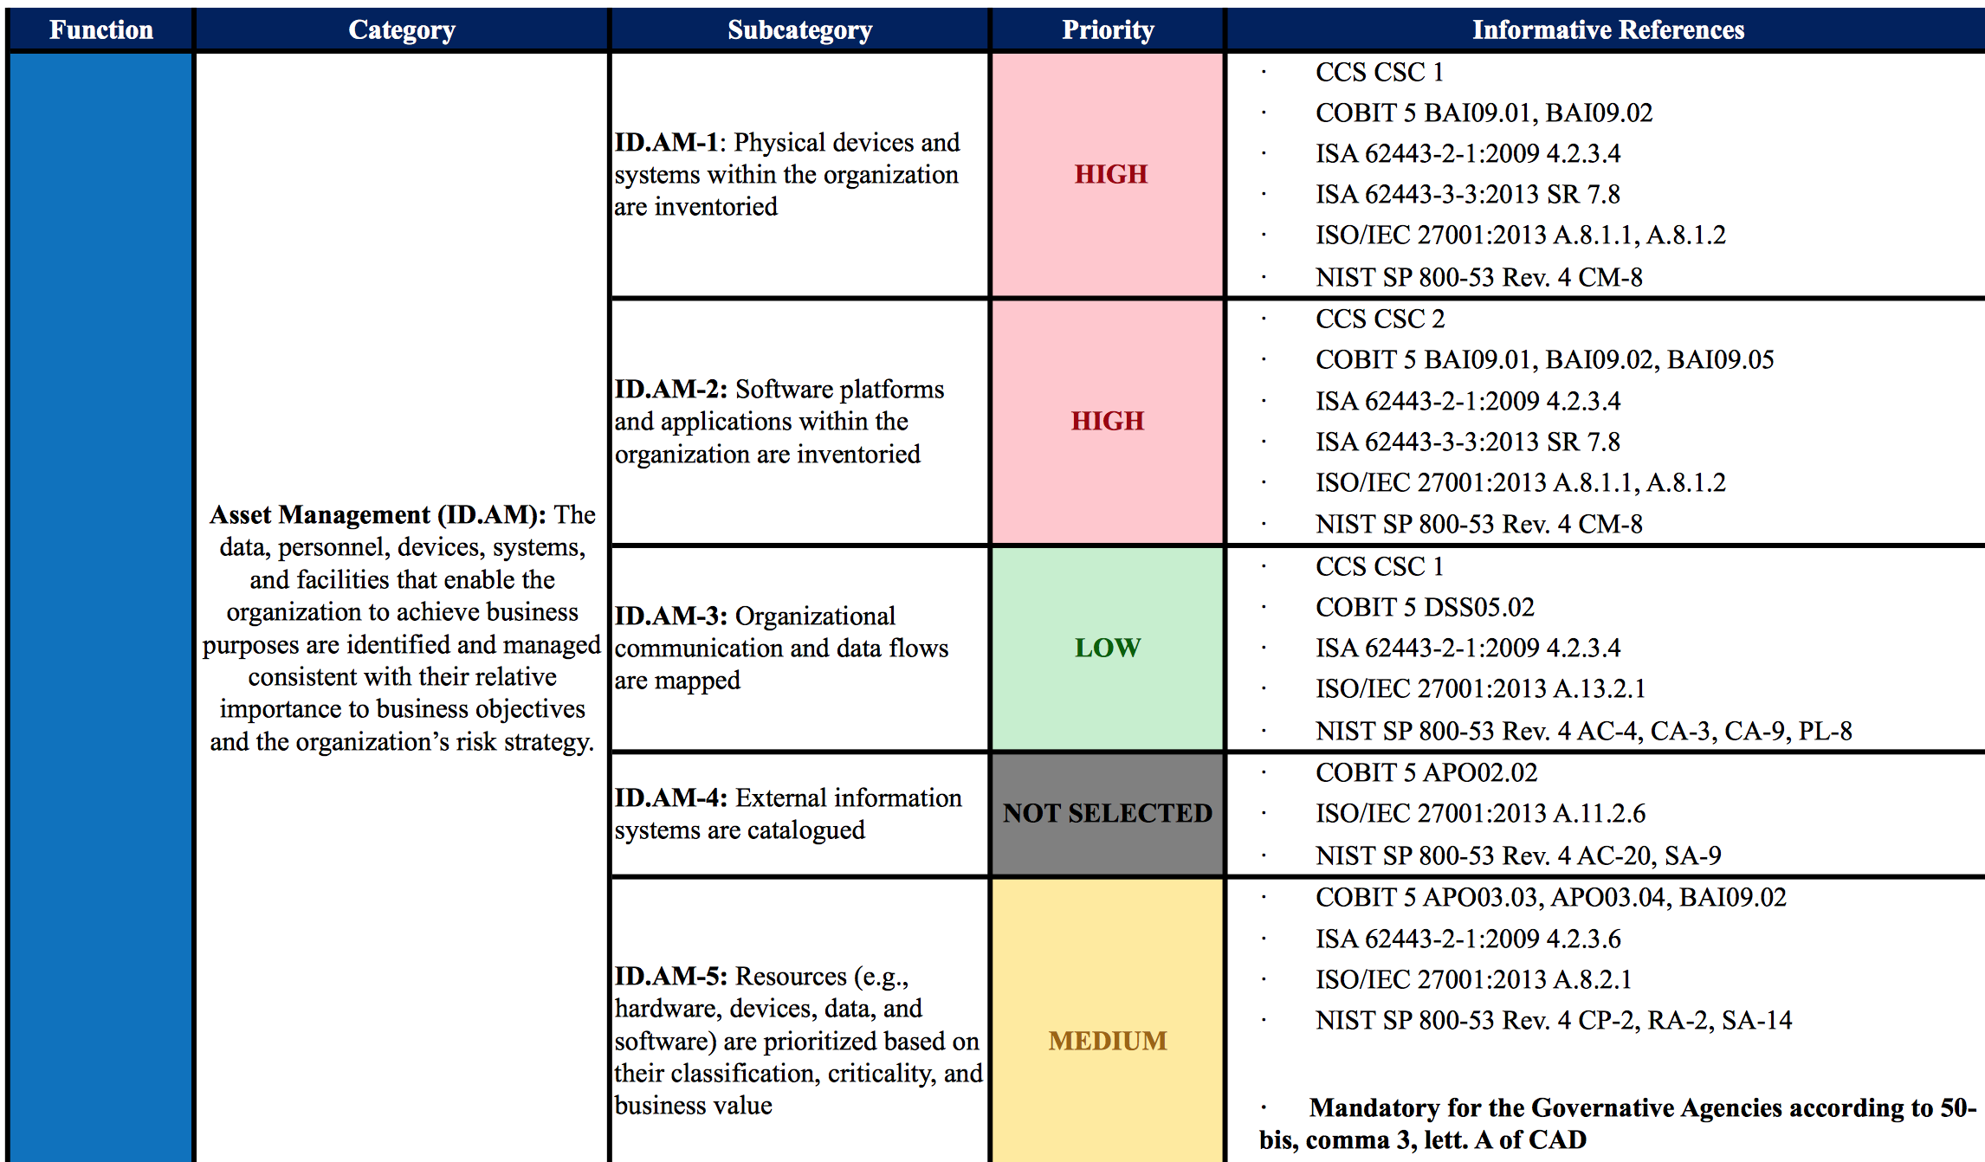
Suggested Priorities for SMEs National Framework for Cybersecurity

Slide 10
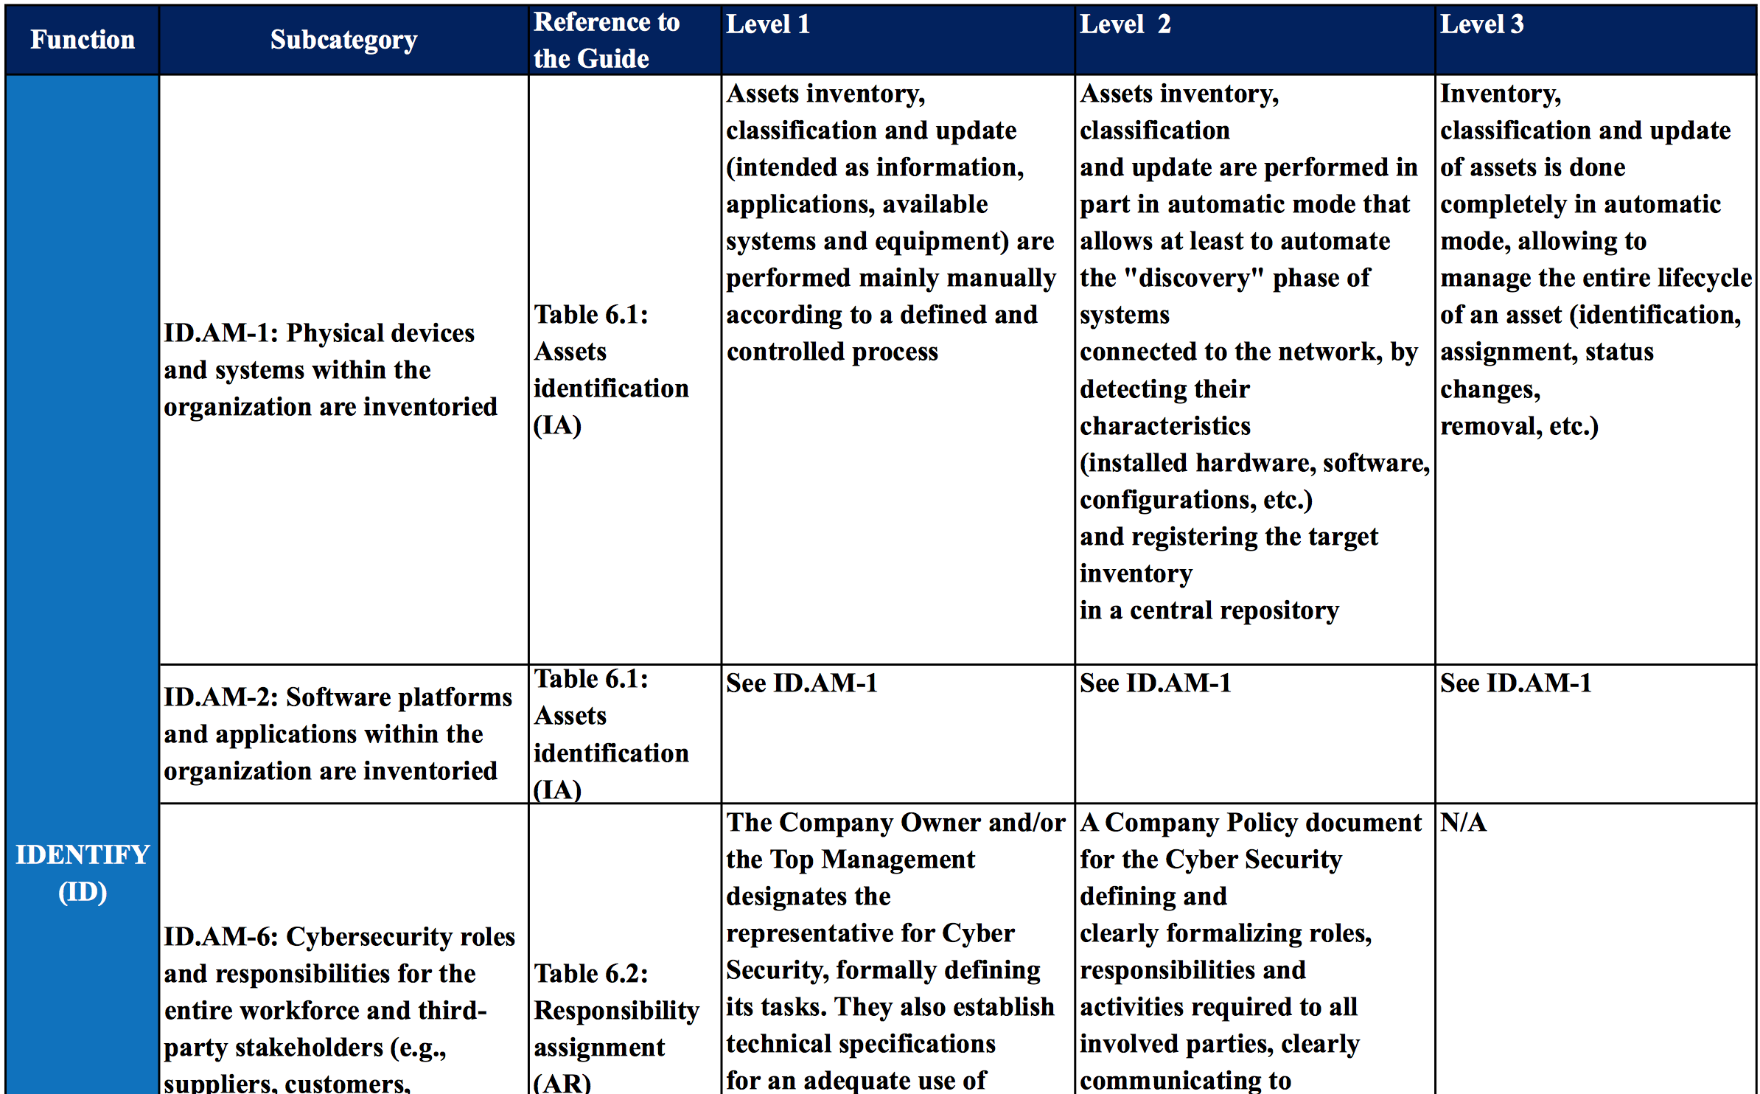
Qualitative Assessment Criteria National Framework for Cybersecurity

Slide 11
American Water Works Association Process Control System Security Guidance for the Water Sector
A 29 page security guide
Recommended Security Practices for Water Sector – a list of 12 major ‘to dos’
A Cybersecurity Guidance Tool to simplify guidance landscape
Crosswalk of Framework to AWWA Guidance Control

Slide 12
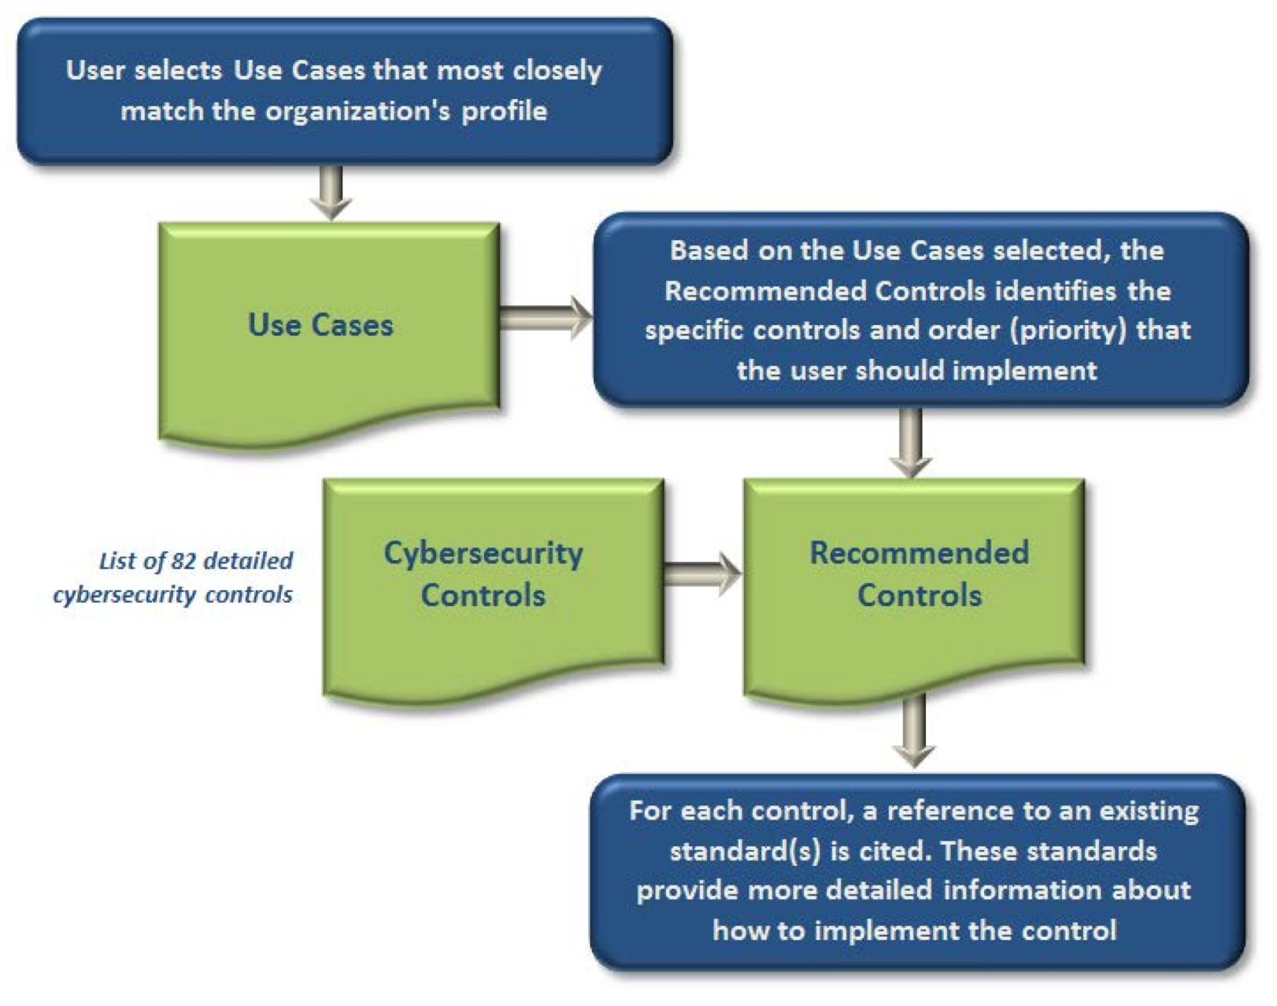
Cybersecurity Guidance ToolProcess Control System Security Guidance for the Water Sector

Slide 13
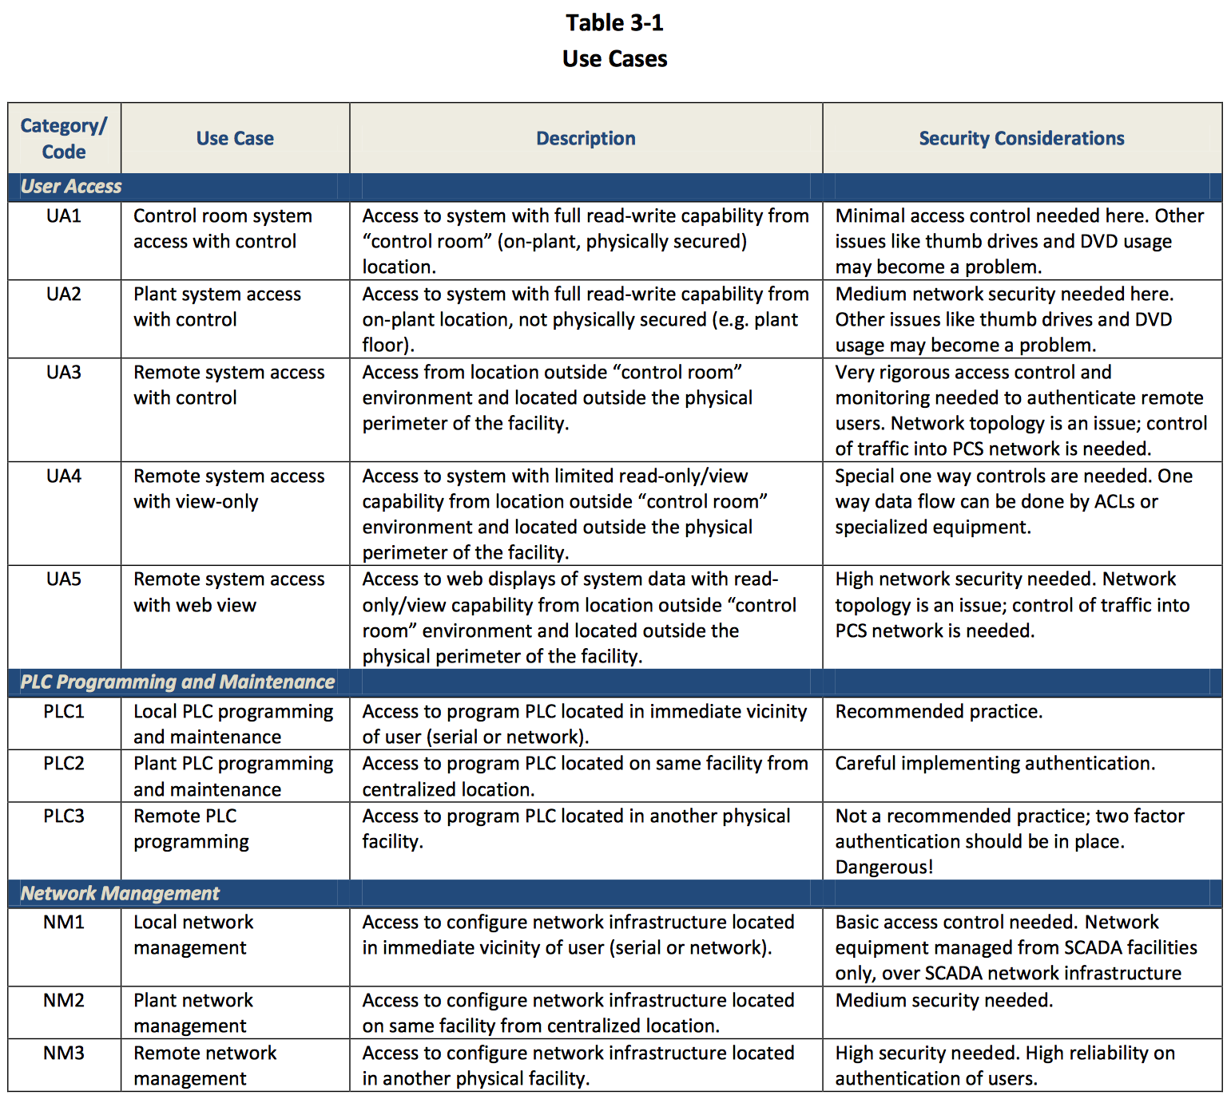
CGT Use Case Examples Process Control System Security Guidance for the Water Sector

Slide 14
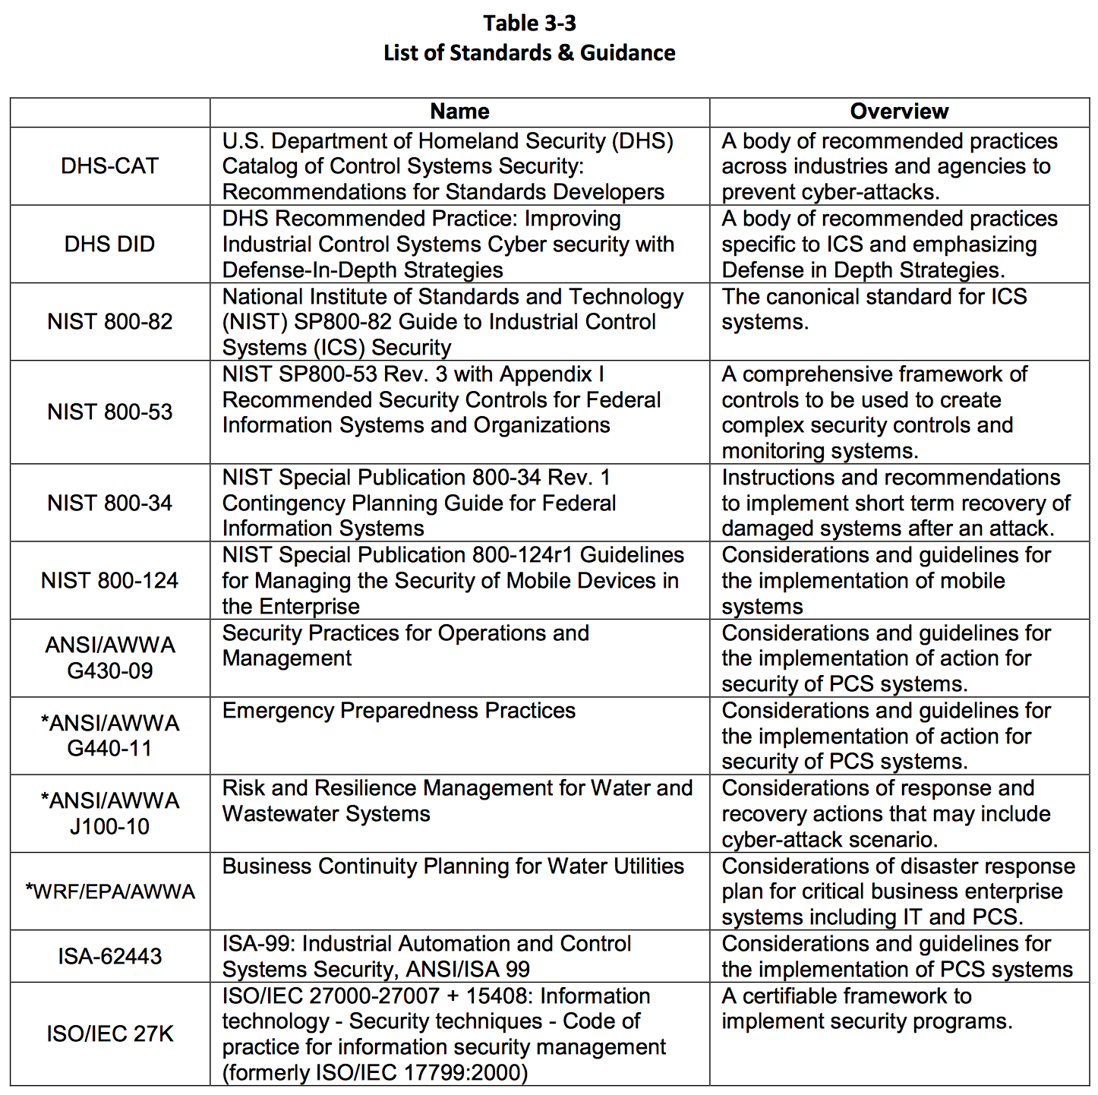
Referenced Standards Process Control System Security Guidance for the Water Sector

Slide 15
Intel The Cybersecurity Framework in Action: An Intel Use Case
A 10 page Framework case study
Pilot in Intel’s Office of Enterprise Infrastructure
Customized Implementation Tiers
Interviewed subject matter experts to assign Tier scores at the Category level
Compared to an optimal Tier assignments at the category level to determine gaps

Slide 16
Implementation Tiers
 | 1 | 2 | 3 |  | 4
 | Partial | Risk Informed | Repeatable |  | Adaptive
Risk Management Process | The functionality and repeatability of cybersecurity risk management
Integrated Risk Management Program | The extent to which cybersecurity is considered in broader risk management decisions
External Participation | The degree to which the organization benefits my sharing or receiving information from outside parties
16

Slide 17
Adaptation of Implementation Tiers
 | 1 | 2 | 3 | 4
 | Partial | Risk Informed | Repeatable | Adaptive
People | Whether people have assigned roles, regular training, take initiative by becoming champions, etc.
Process | NIST Risk Management Process + NIST Integrated Risk Management Program
Technology | Whether tools are implemented, maintained, evolved, provide effectiveness metrics, etc.
Ecosystem | NIST External Participation + Whether the organization understands its role in the ecosystem, including external dependencies with partners
17

Slide 18
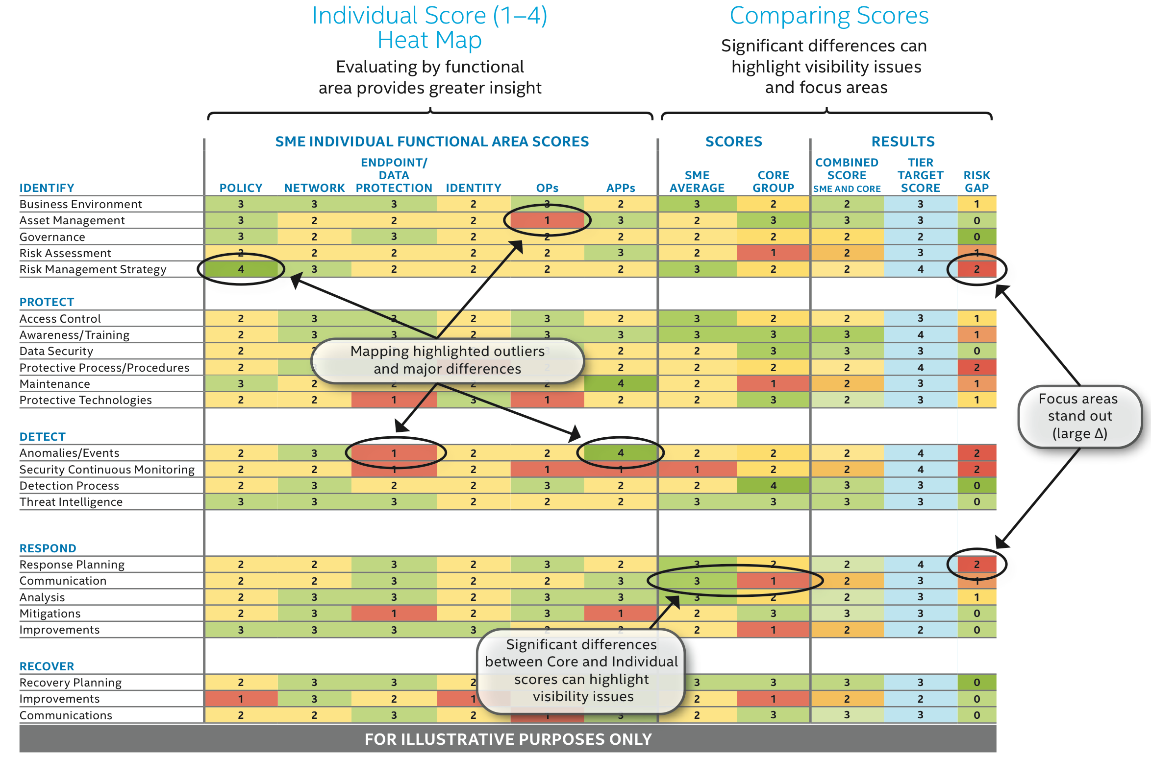
Category Gap Analysis The Cybersecurity Framework in Action: An Intel Use Case
18

Slide 19
Communications Security, Reliability, and Interoperability Council Cybersecurity Risk Management and Best Practices Working Group 4: Final Report
A 400 page security guide
Profiles for five different telecommunications segments – Broadcast, Cable, Satellite, Wireless, Wireline
Requirements and Barriers to Implementation
Small and Medium Business guidance

Slide 20
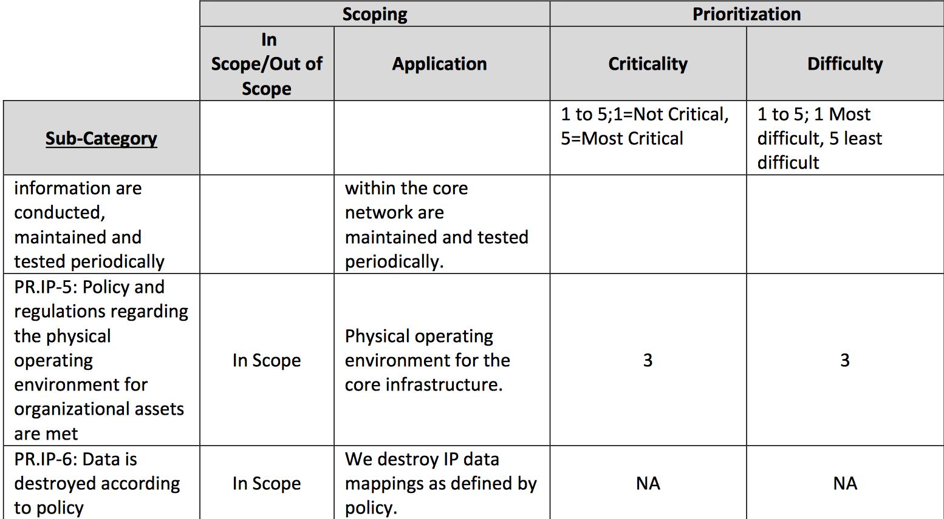
Subcategory Scope, Criticality, and Difficulty - Cable Segment Cybersecurity Risk Management and Best Practices Working Group 4: Final Report

Slide 21
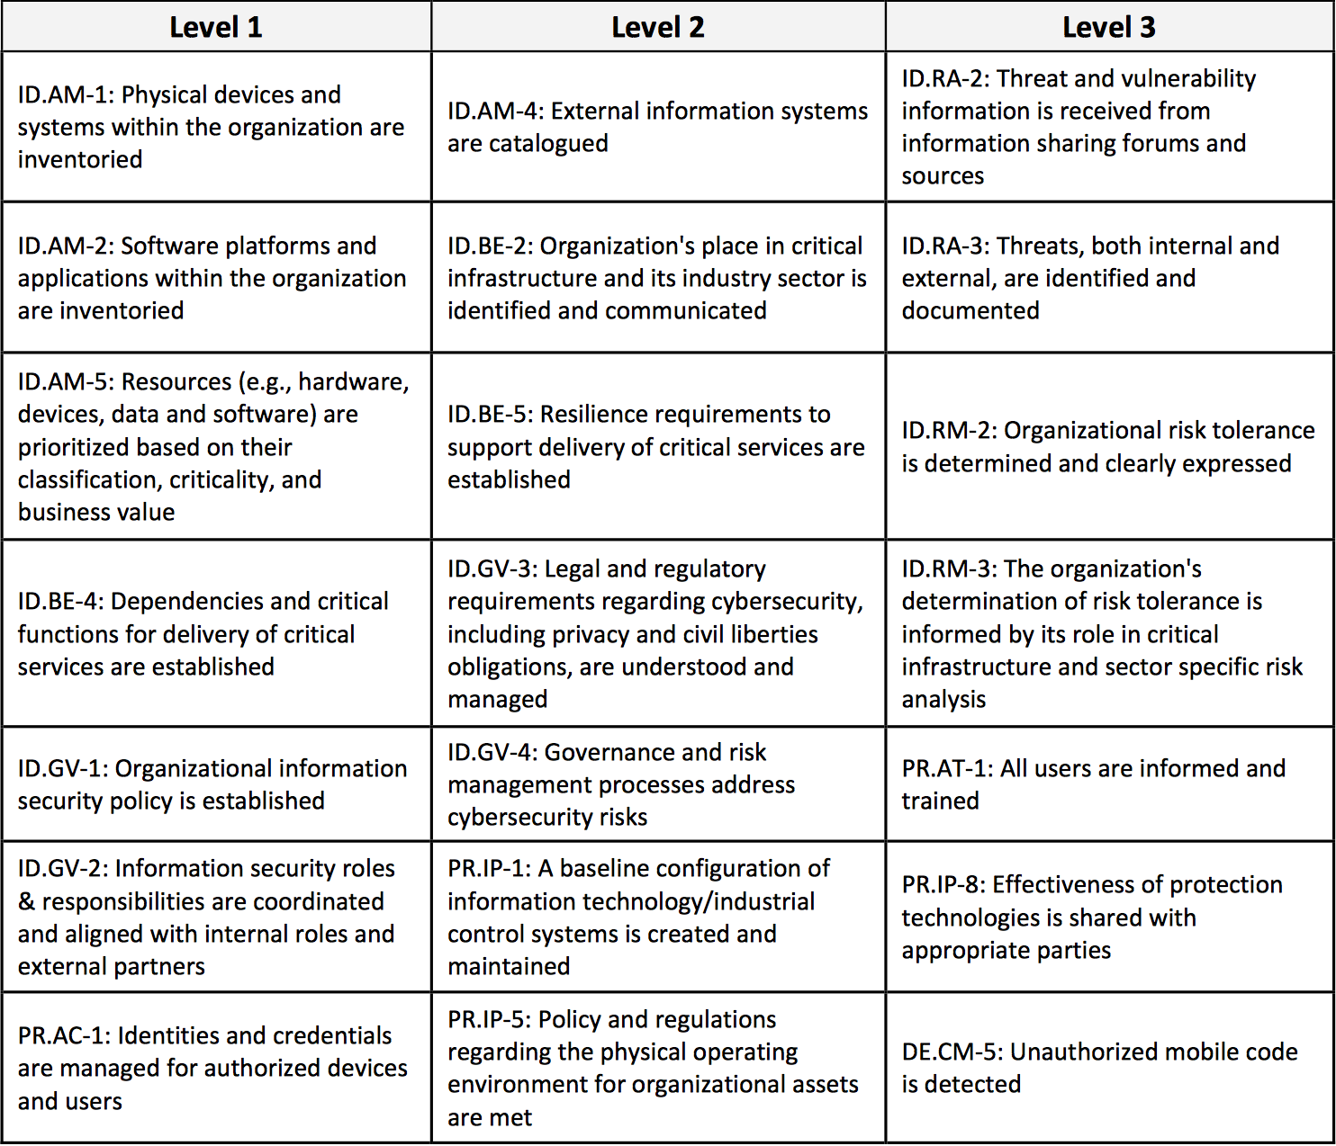
Prioritized Practices - Cable Segment Cybersecurity Risk Management and Best Practices Working Group 4: Final Report

Slide 22
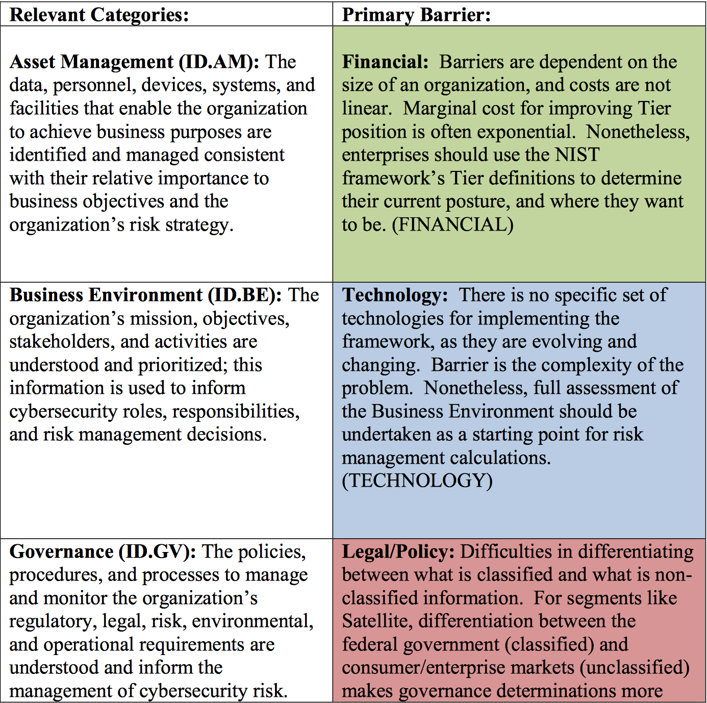
Implementation Requirements and Barriers Cybersecurity Risk Management and Best Practices Working Group 4: Final Report

Slide 23
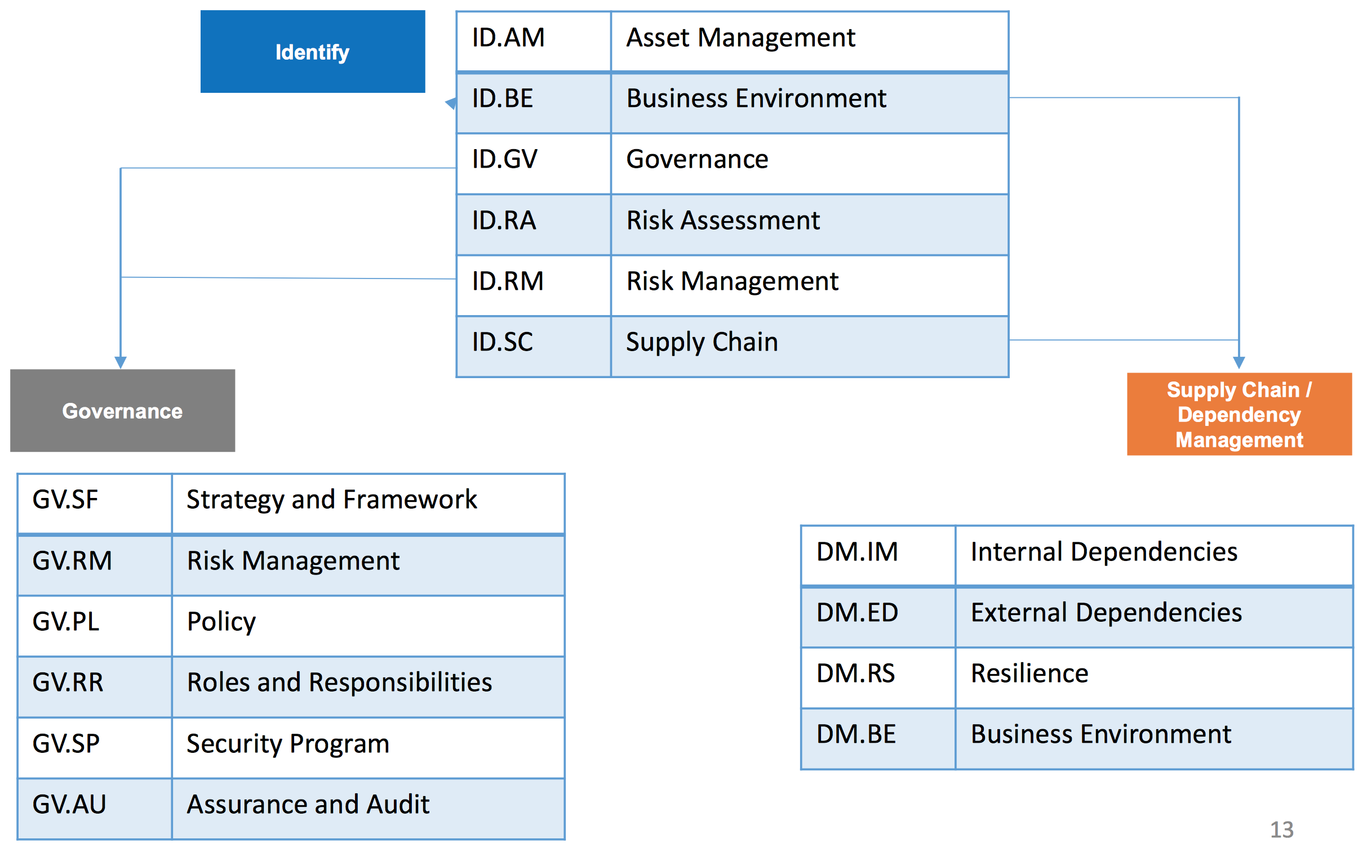
Financial Services Customization The 5 + 2 Model
Notes:
The financial services customization and Profile work is led by the Financial Services Sector Coordinating Council for Critical Infrastructure Protection and Homeland Security (FSSCC)

Slide 24
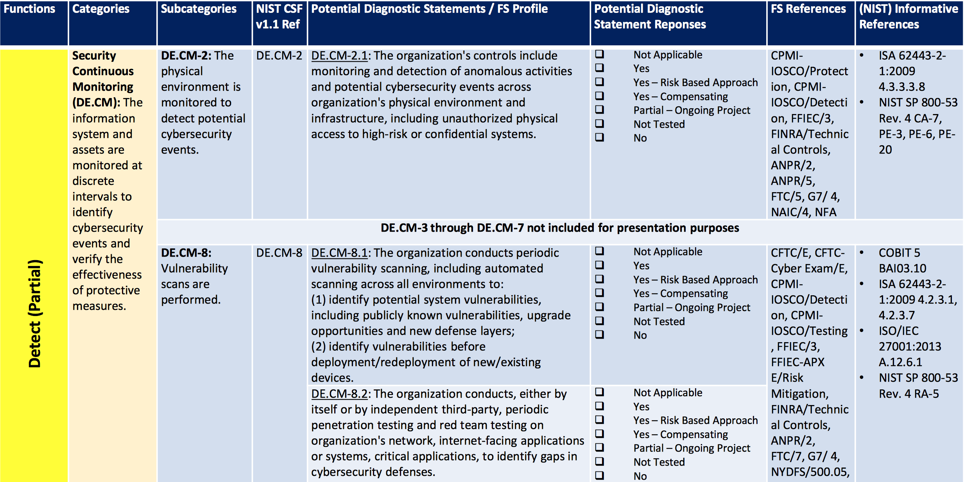
Financial Services Customization Adding Diagnostic Statements to Framework

Slide 25
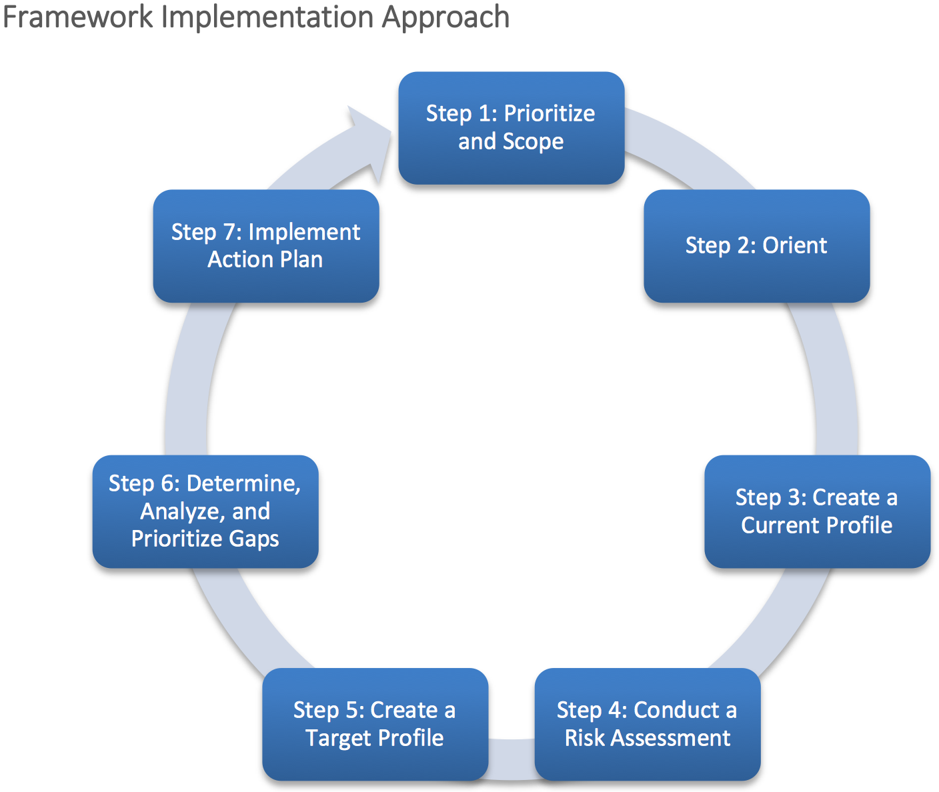
DoE Framework Implementation Approach Energy Sector Cybersecurity Framework Implementation Guidance
An effective communications and an iterative feedback loop for continuous improvement
Similar to Electricity Subsector Cybersecurity Risk Management Process Guideline [RMP; DOE 2012b]

Slide 26
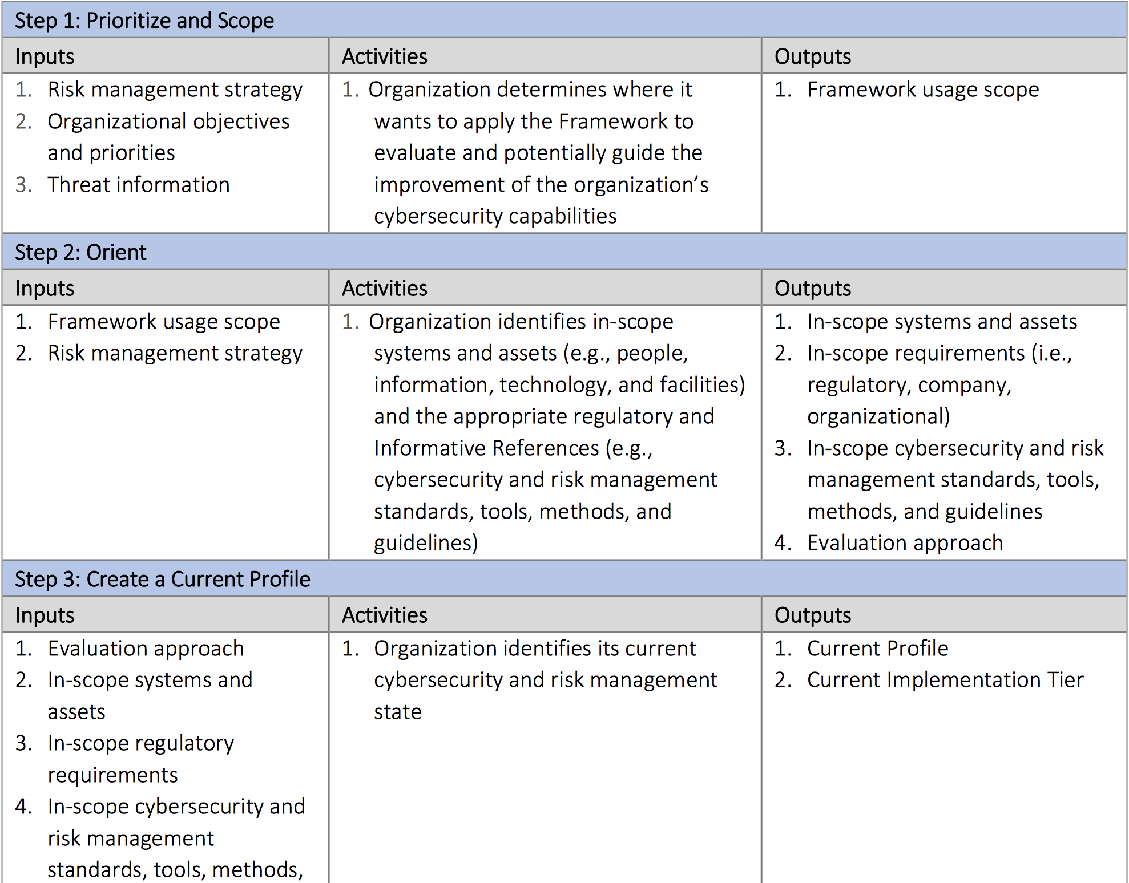
DOE Detailed 7 Step Framework Process Energy Sector Cybersecurity Framework Implementation Guidance

Slide 27
Step 1: Prioritize and Scope Energy Sector Cybersecurity Framework Implementation Guidance
Identify business/mission objectives and high-level organizational priorities
Make strategic decisions regarding cybersecurity implementations
Strategy may be informed by sector-wide critical infrastructure protection objectives and priorities that are generally a shared public- and private-sector concern (see the Electricity Subsector Cybersecurity Risk Management Process Guideline [RMP; DOE 2012b] for a possible approach)
Determine scope of systems and assets that support the selected business line or process
Adapt the Framework per that scope

Slide 28
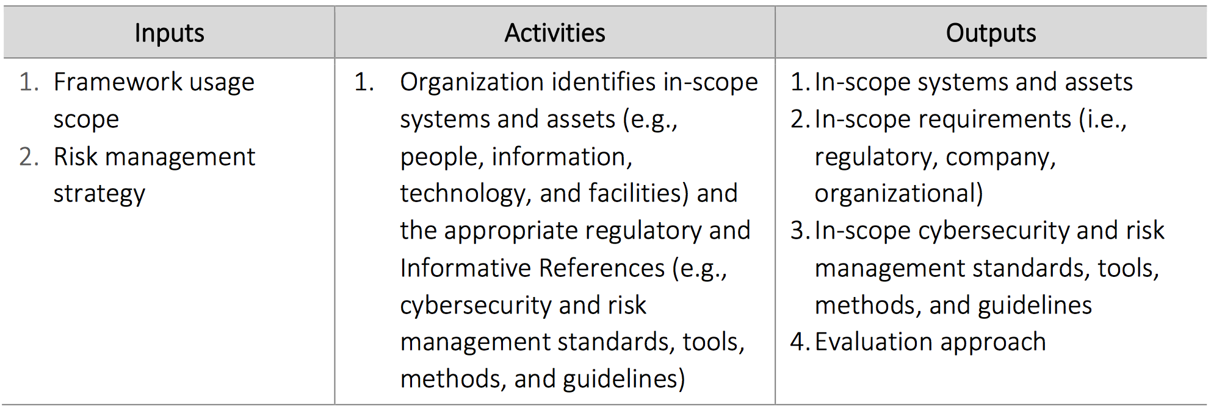
Step 2: Orient Energy Sector Cybersecurity Framework Implementation Guidance
Identify systems and assets, regulatory requirements, and overall risk approach
Identify threats to, and vulnerabilities of, systems and assets

Slide 29
Step 3: Create a Current Profile Energy Sector Cybersecurity Framework Implementation Guidance
Develop a Current Profile by indicating which Category and Subcategory outcomes from the Framework Core are currently being achieved

Slide 30
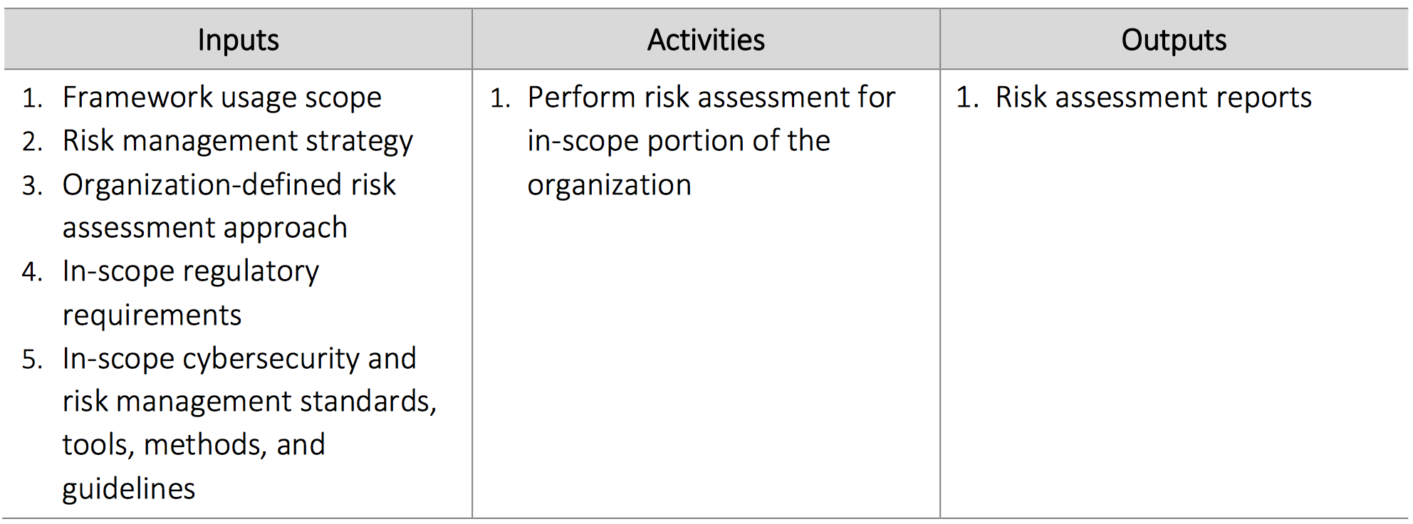
Step 4: Conduct a Risk Assessment Energy Sector Cybersecurity Framework Implementation Guidance
Guided by the organization’s overall risk management process or previous risk assessment activities
Analyze the operational environment in order to discern the likelihood of a cybersecurity event and the impact that the event could have on the organization
Incorporate emerging risks and threat and vulnerability data to facilitate a robust understanding of the likelihood and impact of cybersecurity events
See the Electricity Subsector Cybersecurity Risk Management Process Guideline [DOE 2012b] and Integrating Electricity Subsector Failure Scenarios into a Risk Assessment Methodology [DOE 2013] for possible guidance on performing a cybersecurity risk assessment

Slide 31
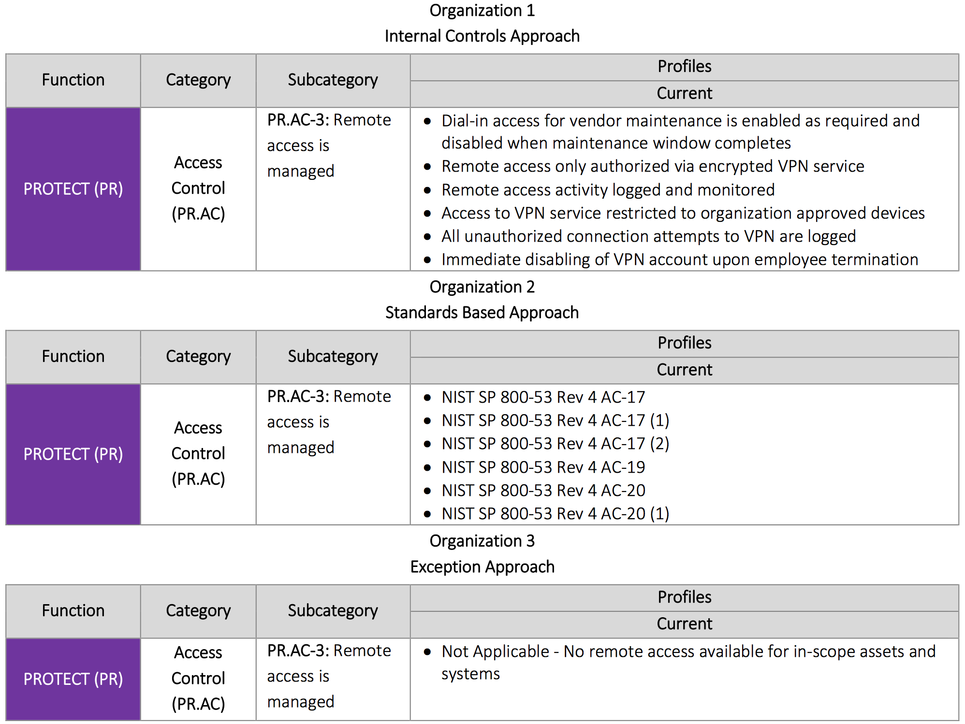
DoE Findings by Organization Approach Energy Sector Cybersecurity Framework Implementation Guidance

Slide 32
Step 5: Create a Target Profile Energy Sector Cybersecurity Framework Implementation Guidance
Create a Target Profile that focuses on the assessment of the Framework Categories and Subcategories describing the organization’s desired cybersecurity outcomes
Consider influences and requirements of external stakeholders such as sector entities, customers, and business partners when creating a Target Profile
(optional) Develop additional Categories and Subcategories to account for unique organizational risks

Slide 33
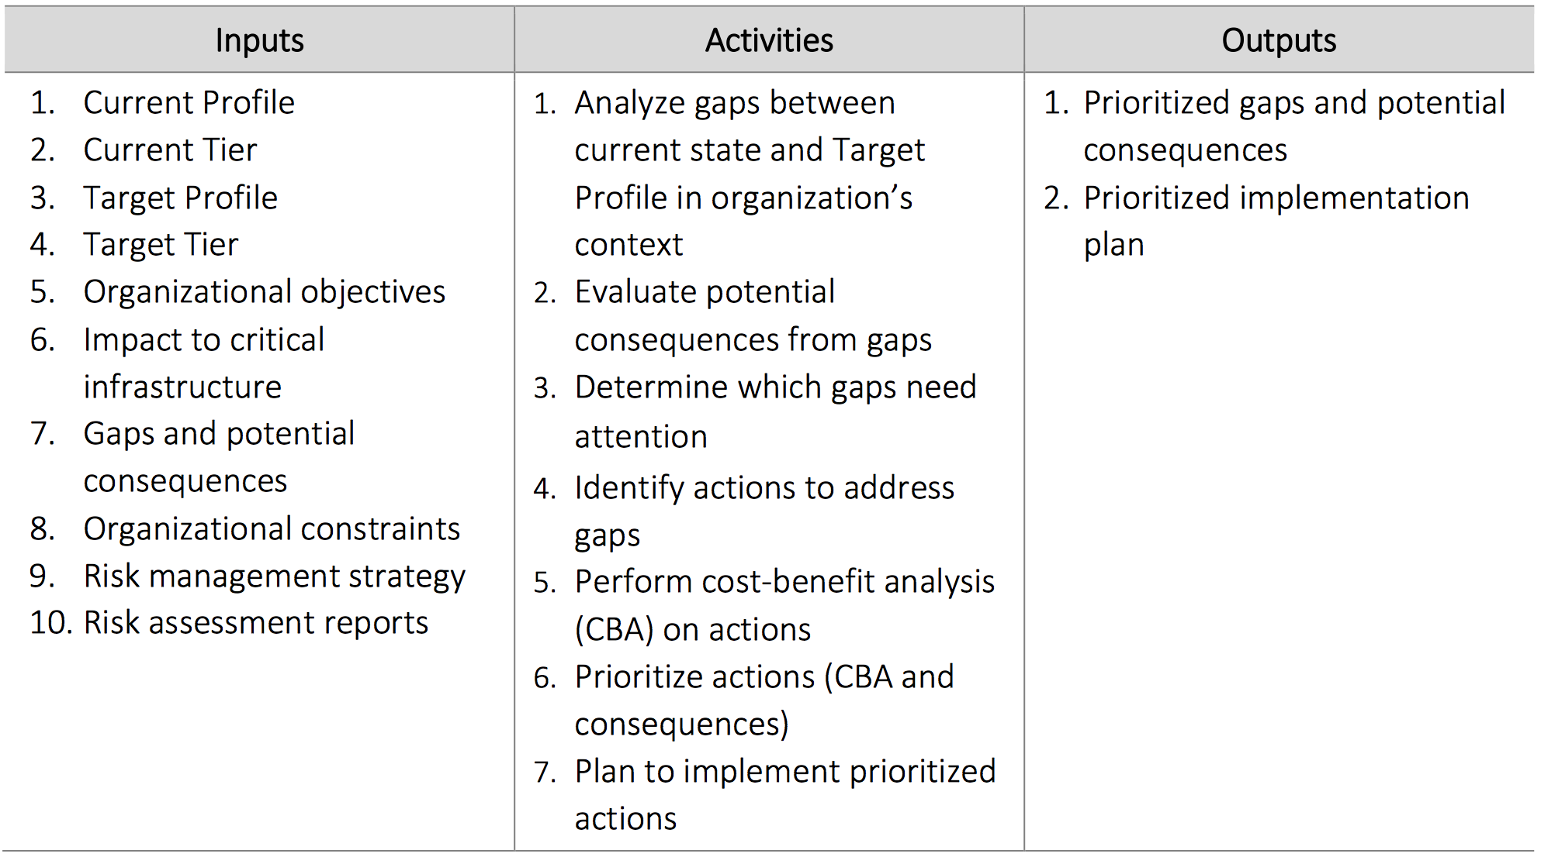
Step 6: Determine, Analyze, and Prioritize Gaps Energy Sector Cybersecurity Framework Implementation Guidance
Compare Current Profile and the Target Profile to determine gaps
Determine resources necessary to address the gaps
Create a prioritized action plan to address those gaps

Slide 34
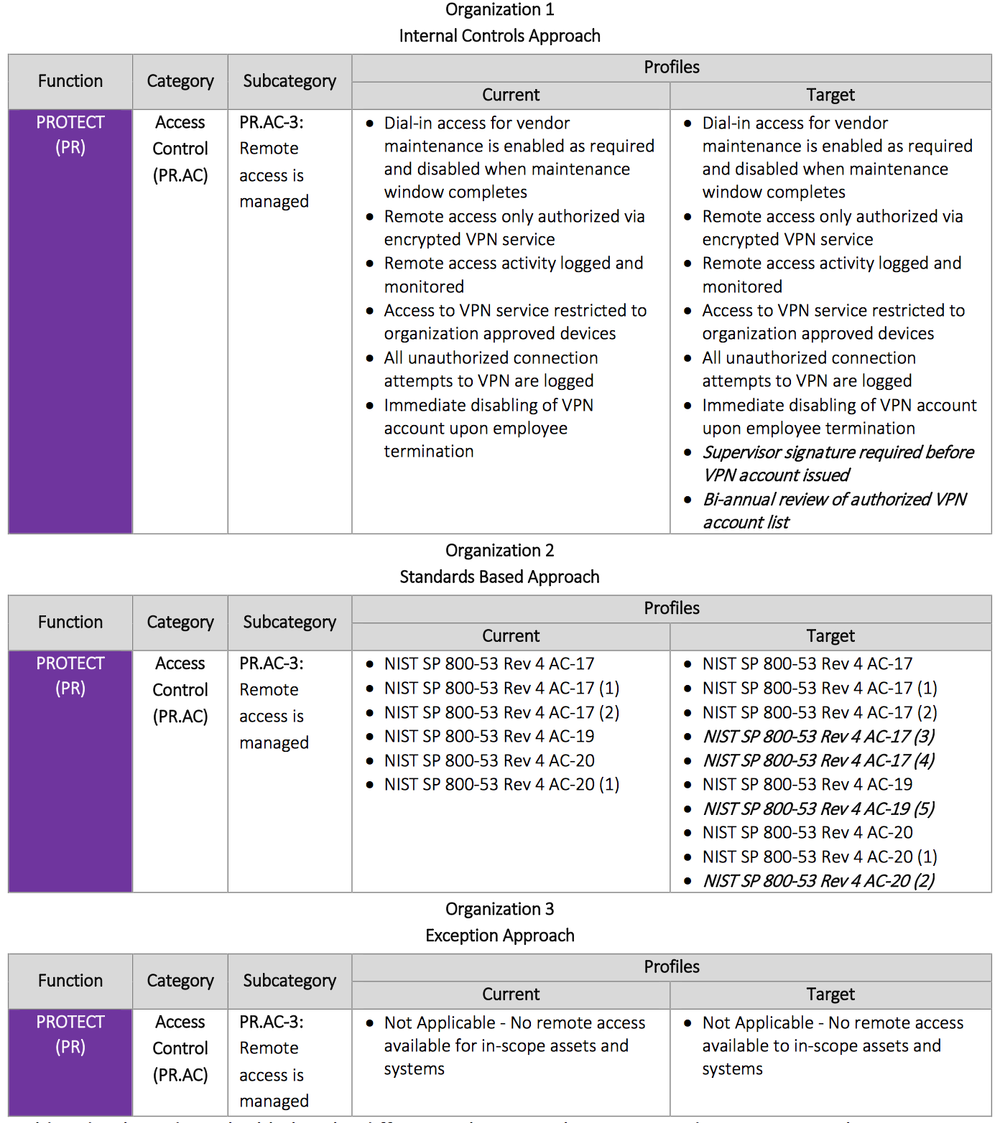
DoE Gap Analysis by Organization Approach Energy Sector Cybersecurity Framework Implementation Guidance

Slide 35
Step 7: Implement Action Plan Energy Sector Cybersecurity Framework Implementation Guidance
Determine which actions to take in regards to the gaps, if any, identified in the previous step
Monitor current cybersecurity practices against the Target Profile - the Framework identifies example Informative References regarding the Categories and Subcategories, but organizations should determine which standards, guidelines, and practices, including those that are sector specific, work best for their needs.

Slide 36
Resources Where to Learn More and Stay Current
The National Institute of Standards and Technology Web site is available at http://www.nist.gov
NIST Computer Security Division Computer Security Resource Center is available at http://csrc.nist.gov/
The Framework for Improving Critical Infrastructure Cybersecurity and related news and information are available at www.nist.gov/cyberframework
For additional Framework info and help cyberframework@nist.gov

